Slide 1
GAN
(Cifar 10)
Tan Wen Tao Bryan (2214449)
Ryan Yeo (2214452)
DAAA/FT/2B/01

Slide 2
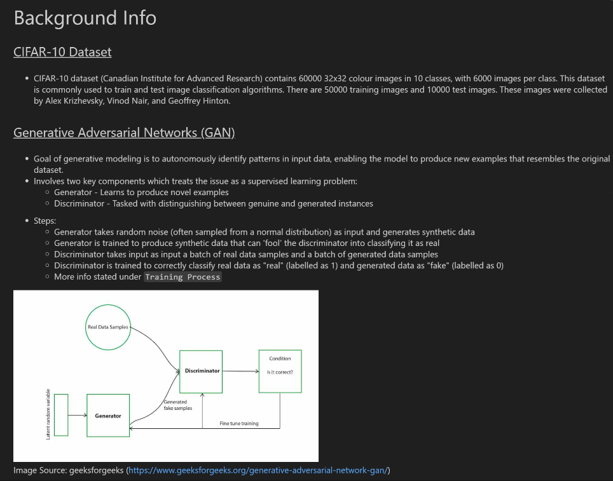
Background Information

Slide 3
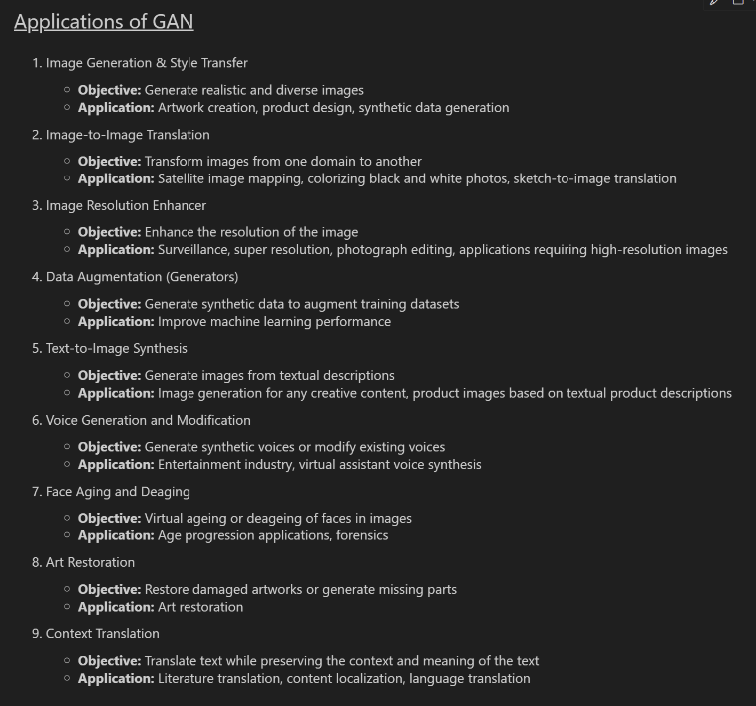
Applications of GAN

Slide 4
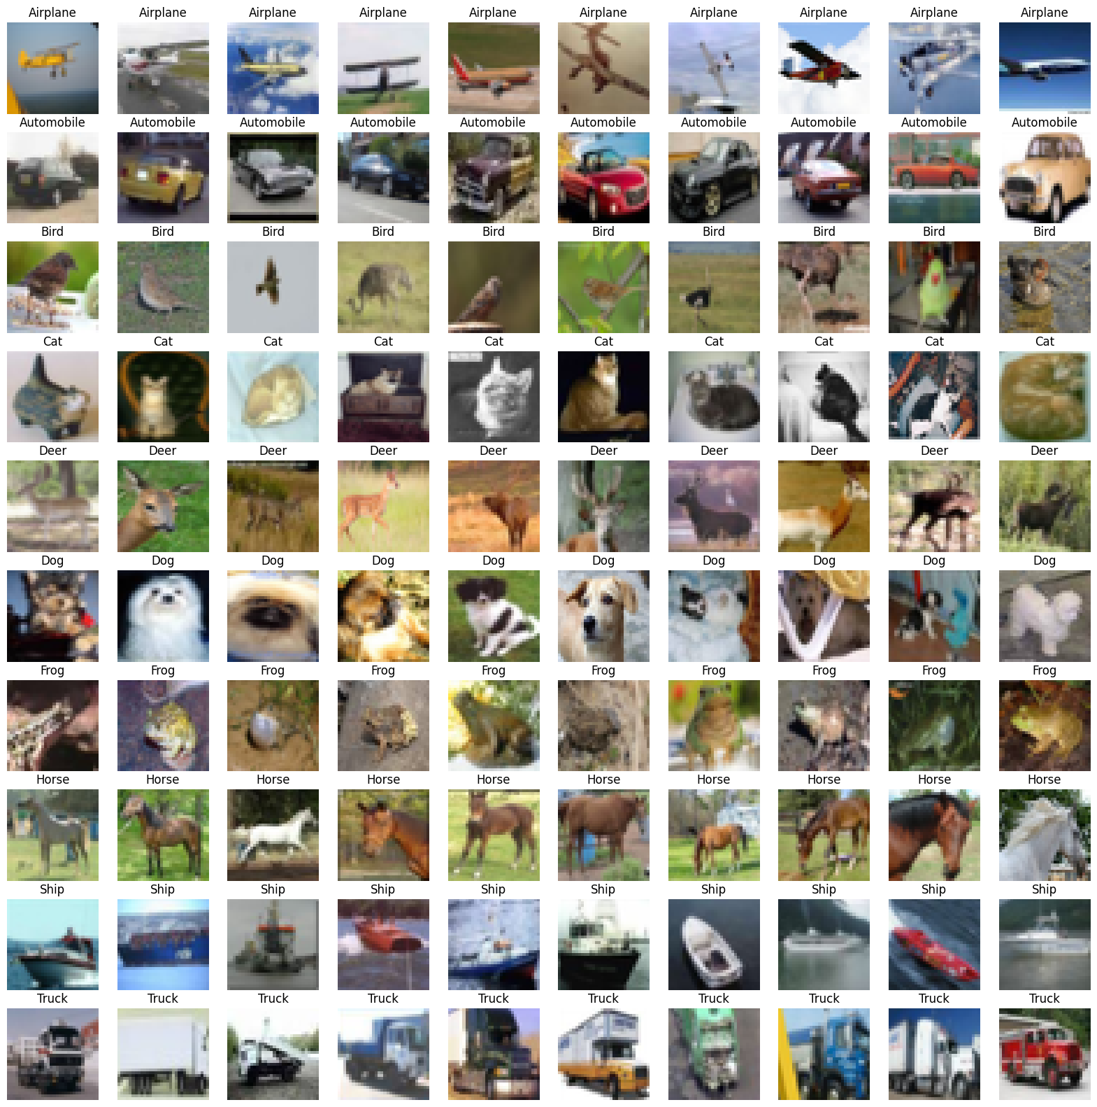

EDA
For certain animals like Horse, Cat are very zoomed in. Images can sometimes be a face of an animal and sometime contain the entire body of the animal.
Birds contain different species which the model might not be able to classify.
Each image from the same class can have different features, which can make it hard for the models to learn.

Slide 5
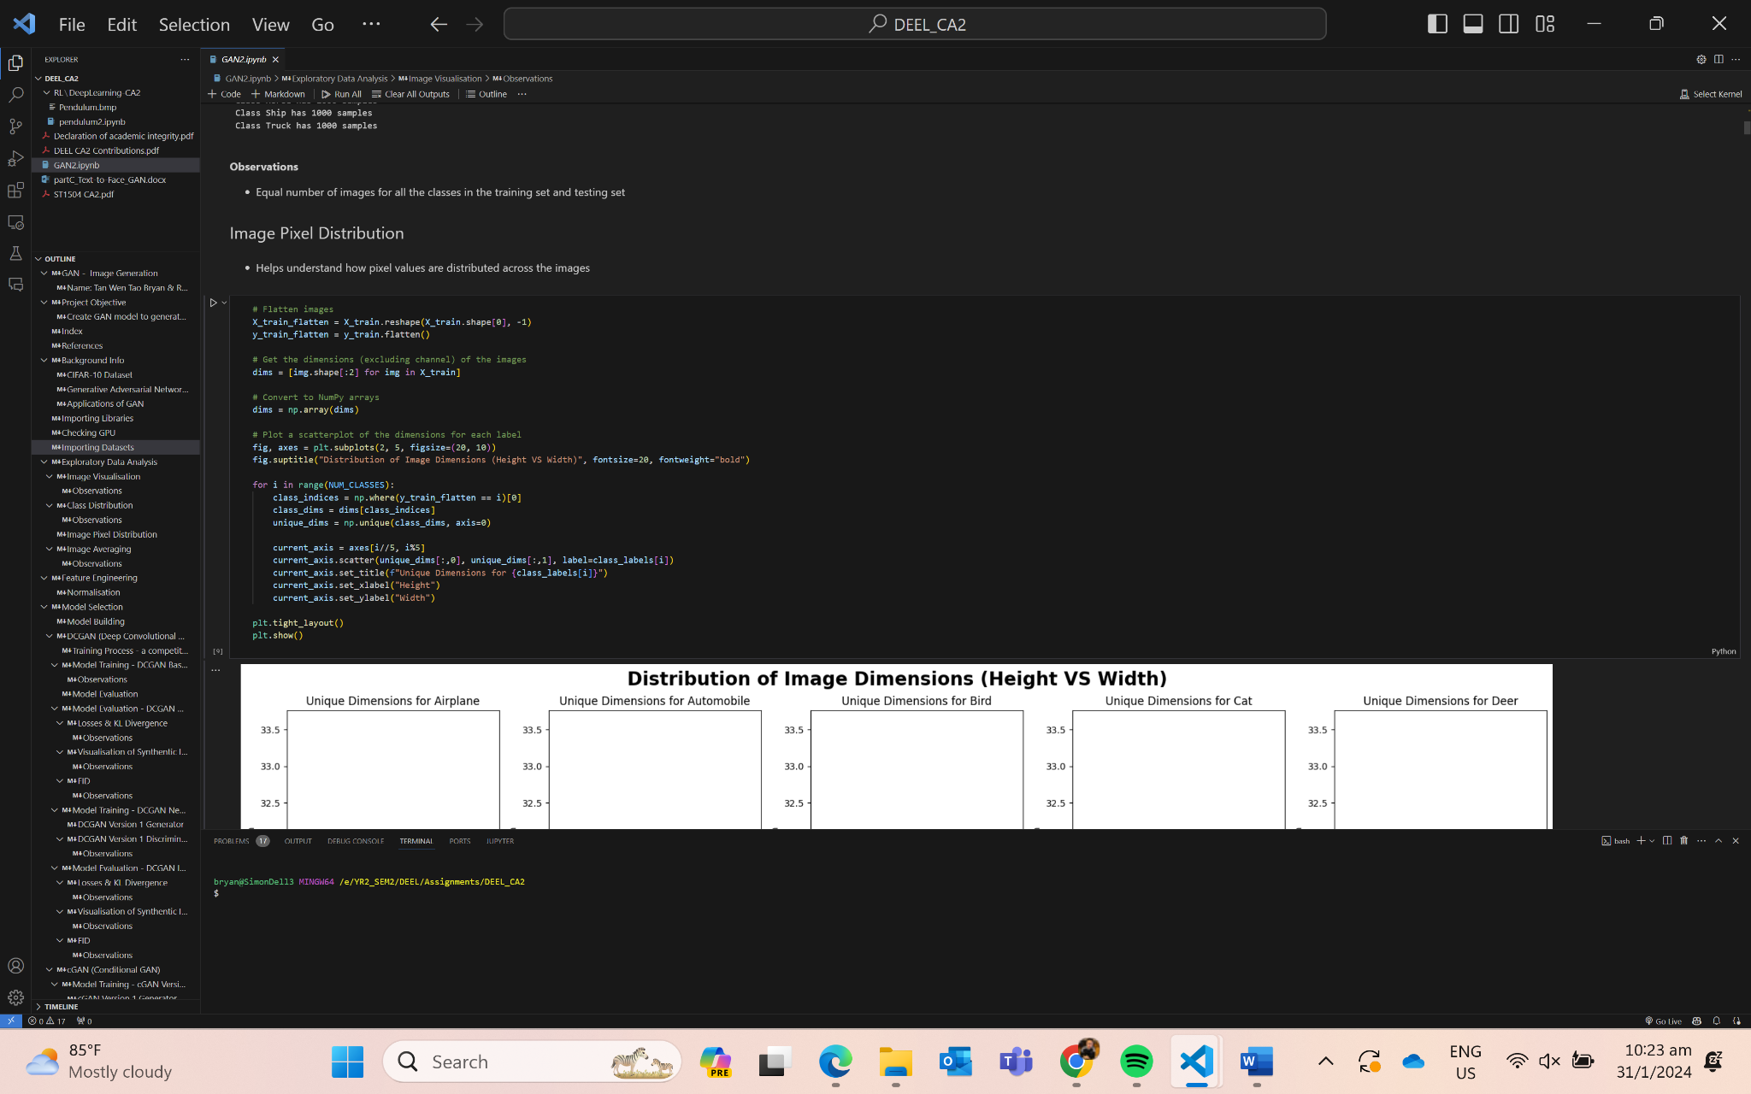

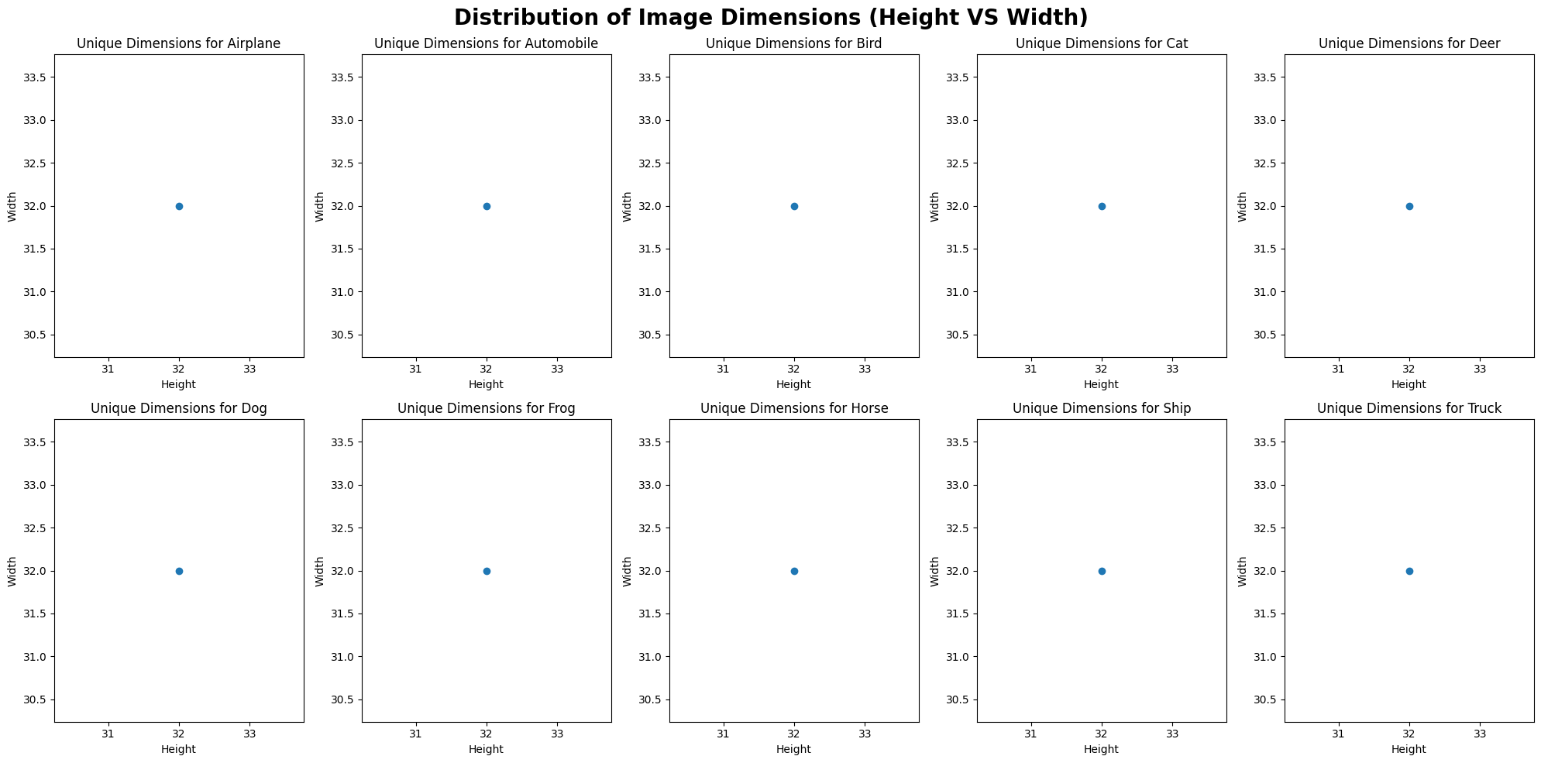
EDA
All image pixels are 32x32

Slide 6
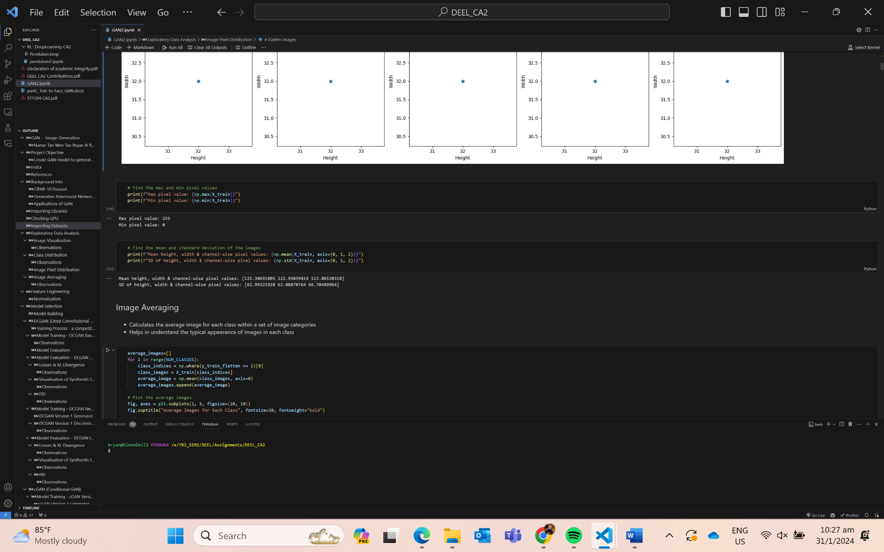
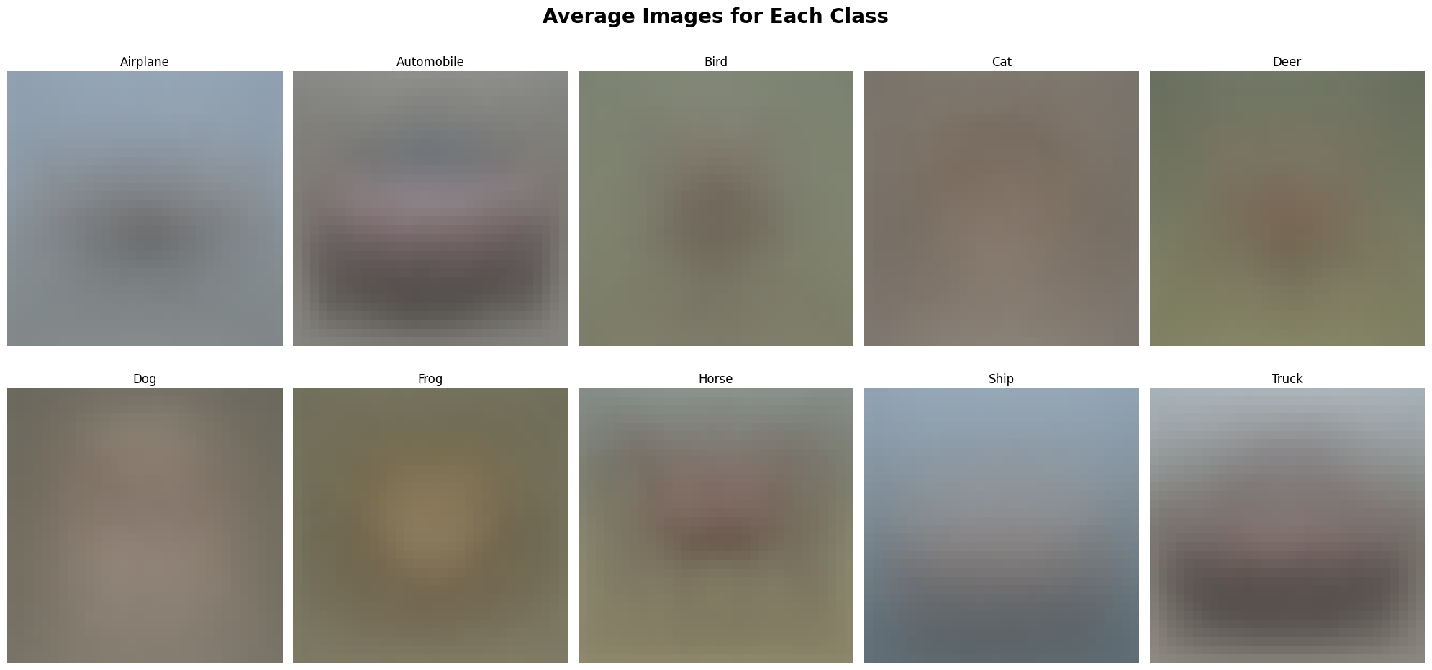

EDA
Average images are blur as the images are overlapping one another.
We can make out the images of an automobile which shows that the representative features of these training images will be better than the other classes and images generated for those classes.

Slide 7

Feature Engineering

Slide 8
Model Training
Architecture List
DCGAN (Baseline Model)
DCGAN (Weight Normalization + Gaussian Noise)
cGAN (Version 1)
cGAN (Weight Normalization + Gaussian Noise)
ACGAN (Version 1)
ACGAN (Kernel Initializer + Random Normal Noise)
ACGAN (Spectral Normalization + Kernel Initializer)

Slide 9

DCGAN (Model Training)

Slide 10

DCGAN (Model Training) - Class Constructors
Metrics Collected by DCGAN:
Training Loss (Generator + Discriminator)
Discriminator Training Accuracy (Real + Fake)
KL Divergence
Calculation for Discriminator Accuracy

Slide 11


DCGAN (Model Training) - Train Function
Add noise to the data and train on each batch
Prints 10 images every 5 epochs
Save weights every 10 epochs
Train disc & gen per epoch
Loading weights function such that we can load and train GAN models at certain epochs

Slide 12
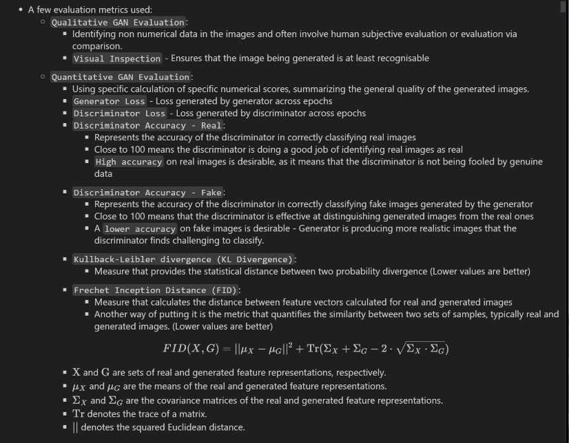
Model Evaluation
Evaluation Metrics
Qualitative Metrics:
Visual Inspection
Quantitative Metrics:
Generator loss
Discriminator loss
Discriminator accuracy (Real)
Discriminator accuracy (Fake)
KL Divergence
Frechet Inception Distance (FID)

Slide 13

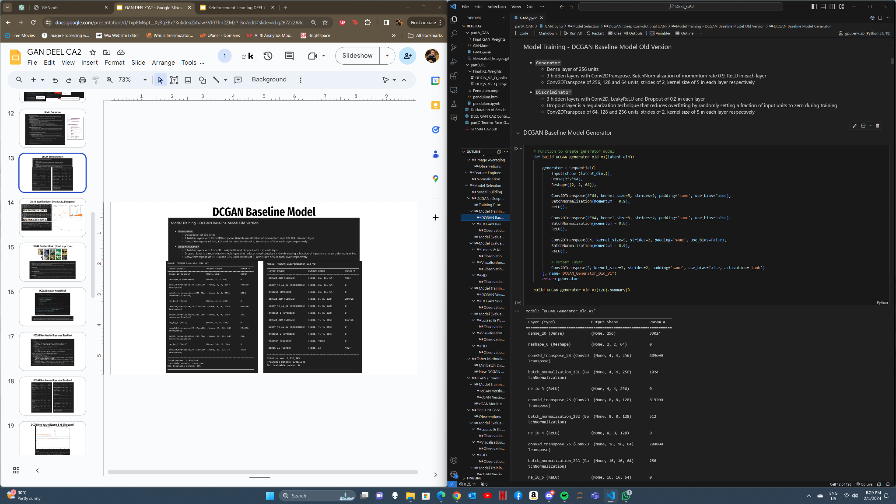
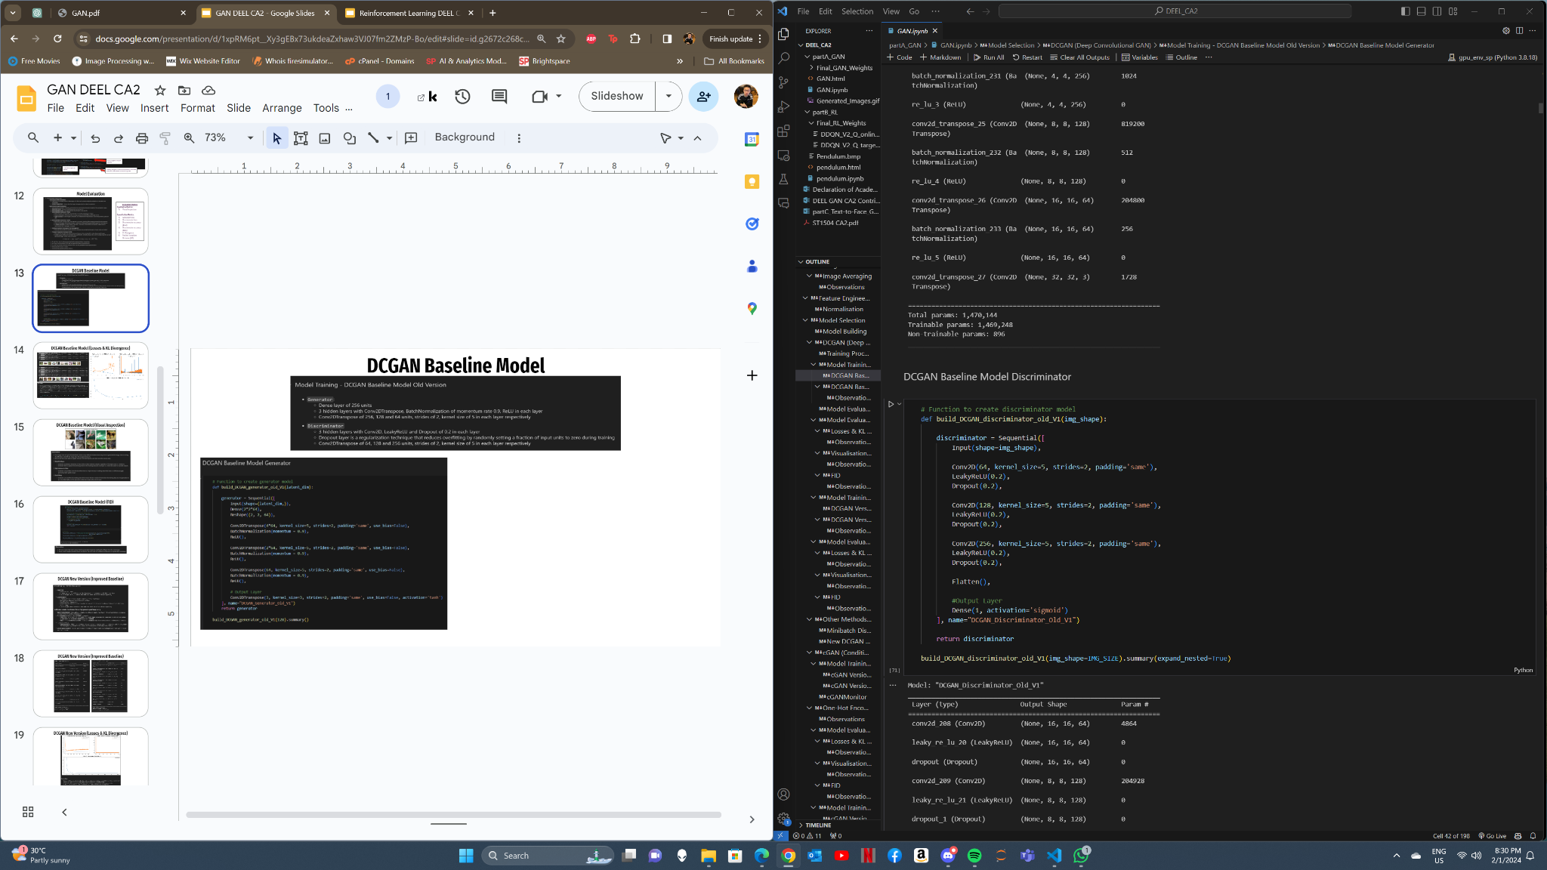
DCGAN Baseline Model

Slide 14
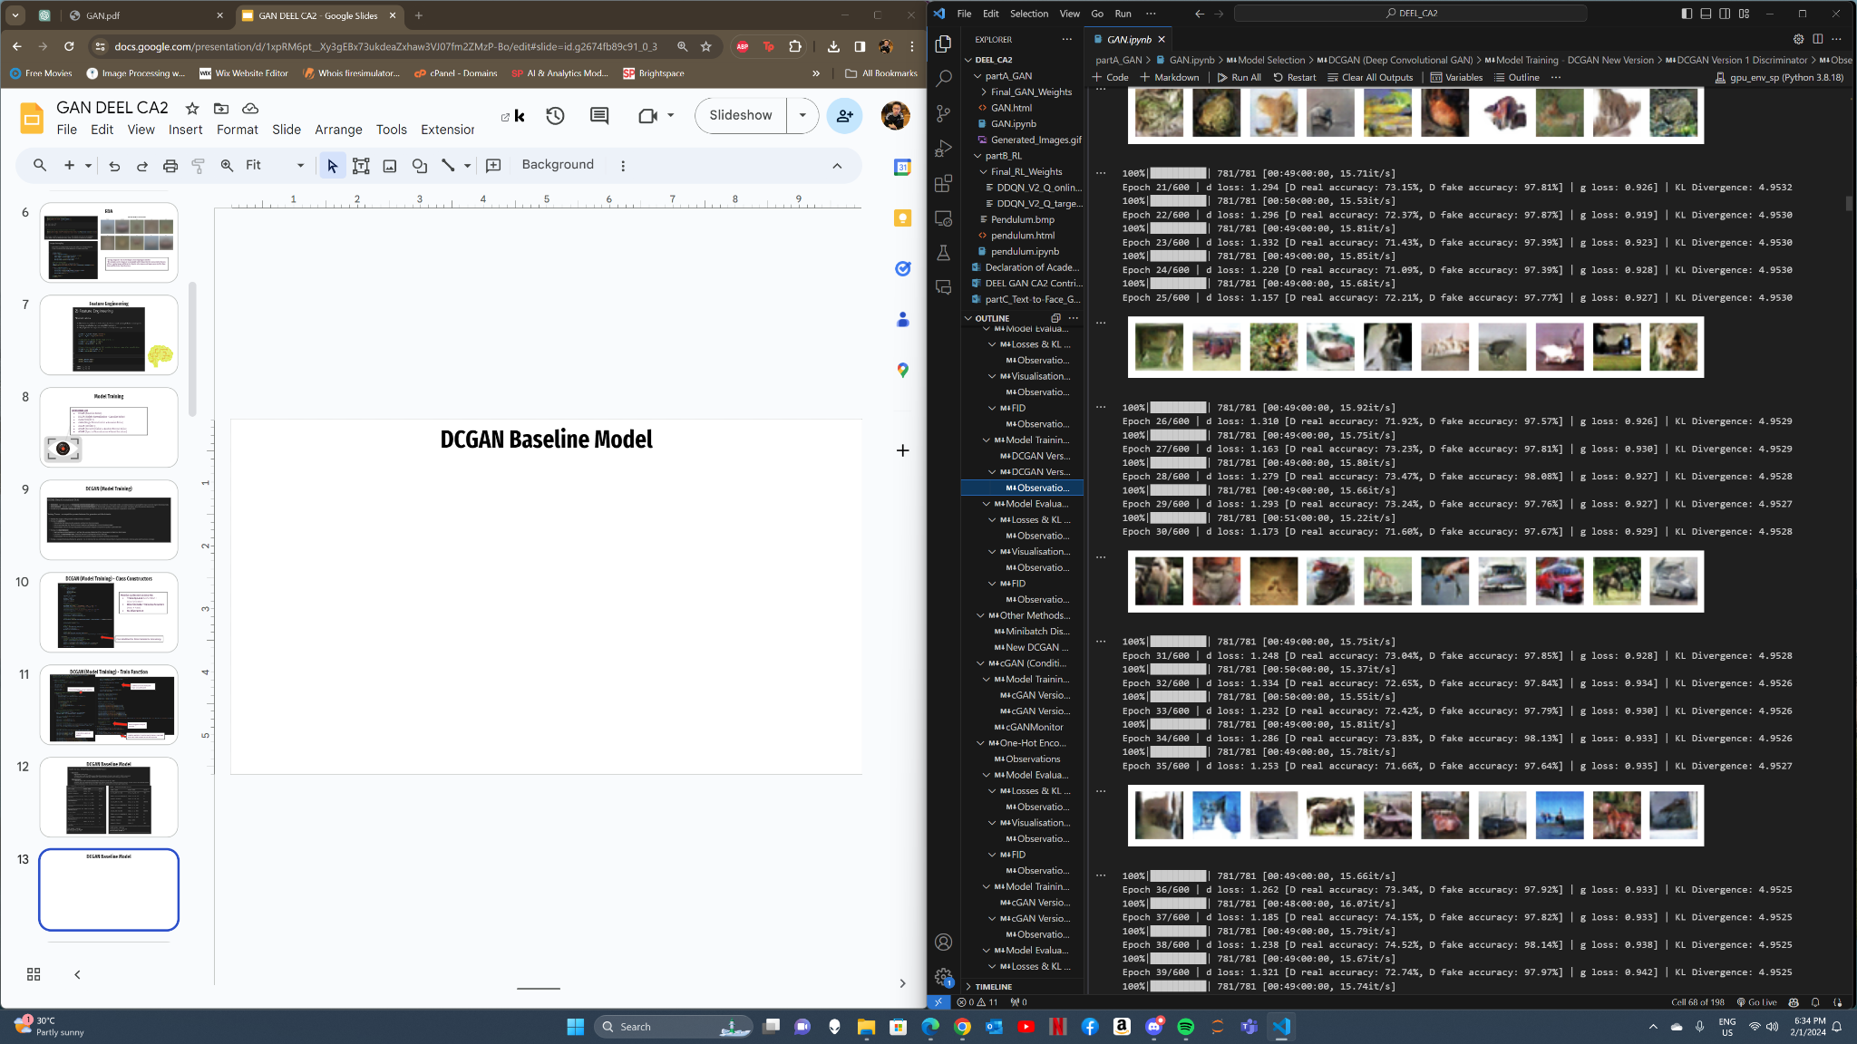
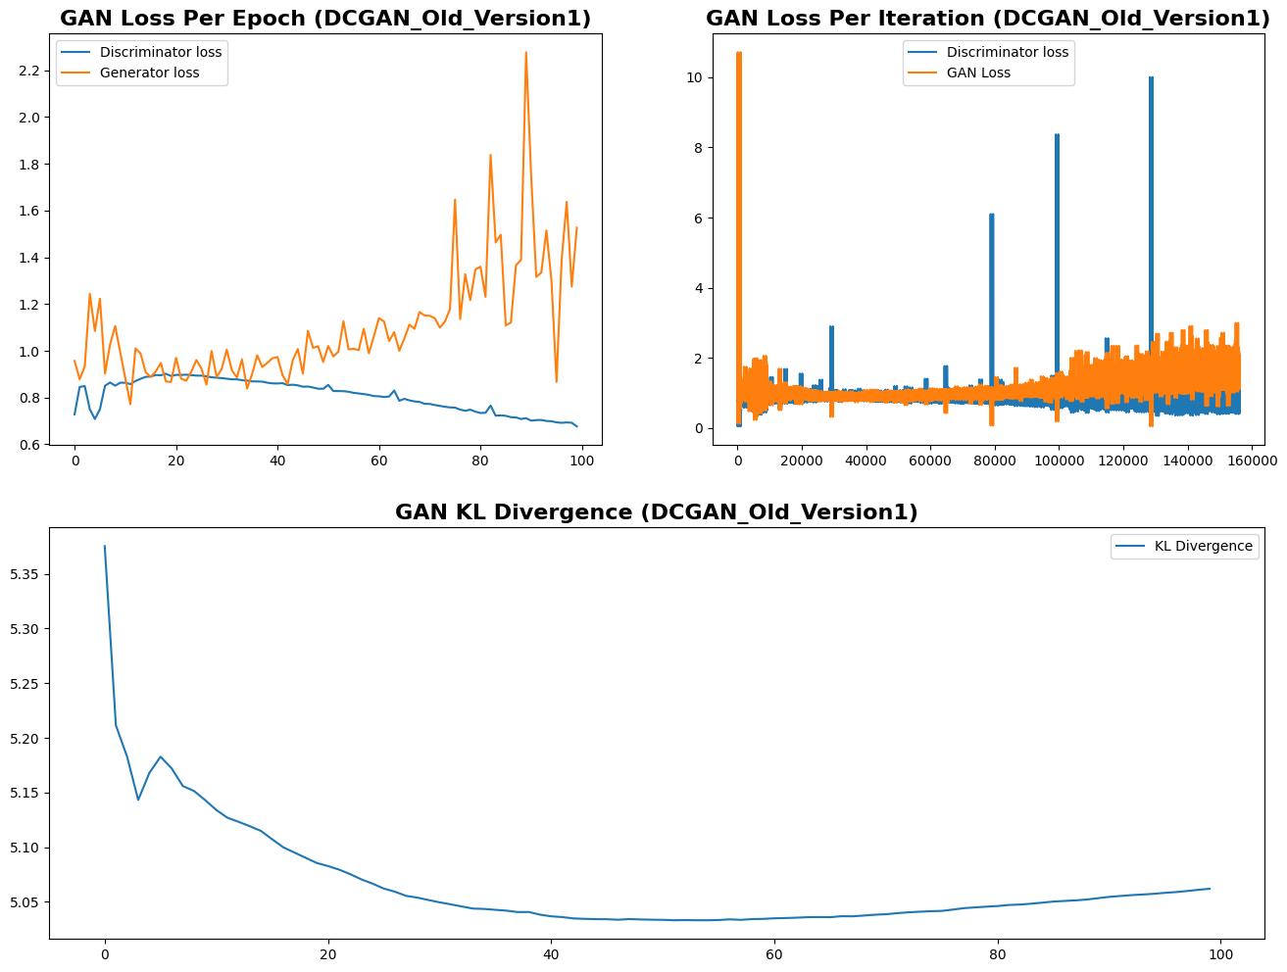
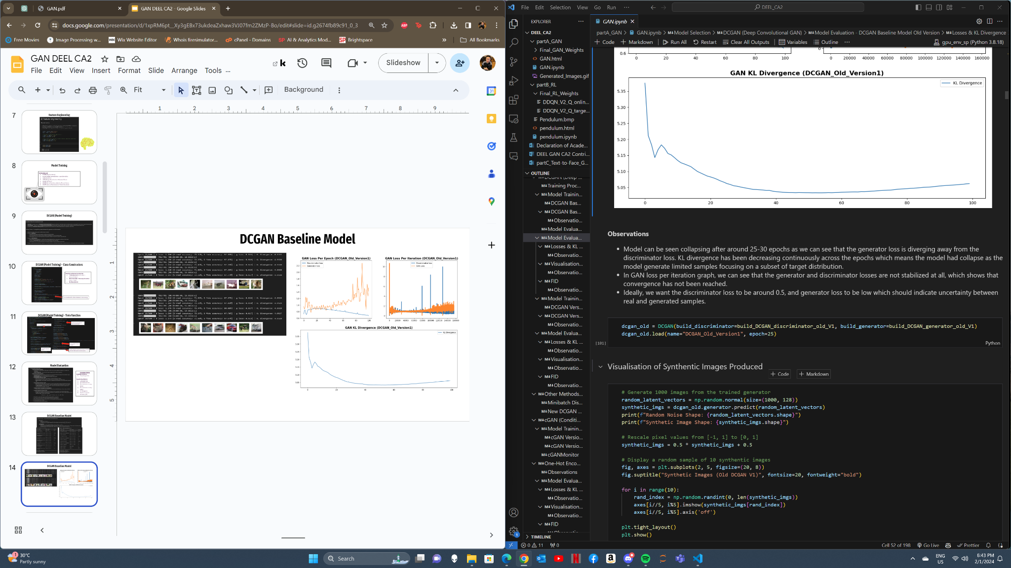
DCGAN Baseline Model (Losses & KL Divergence)

Slide 15
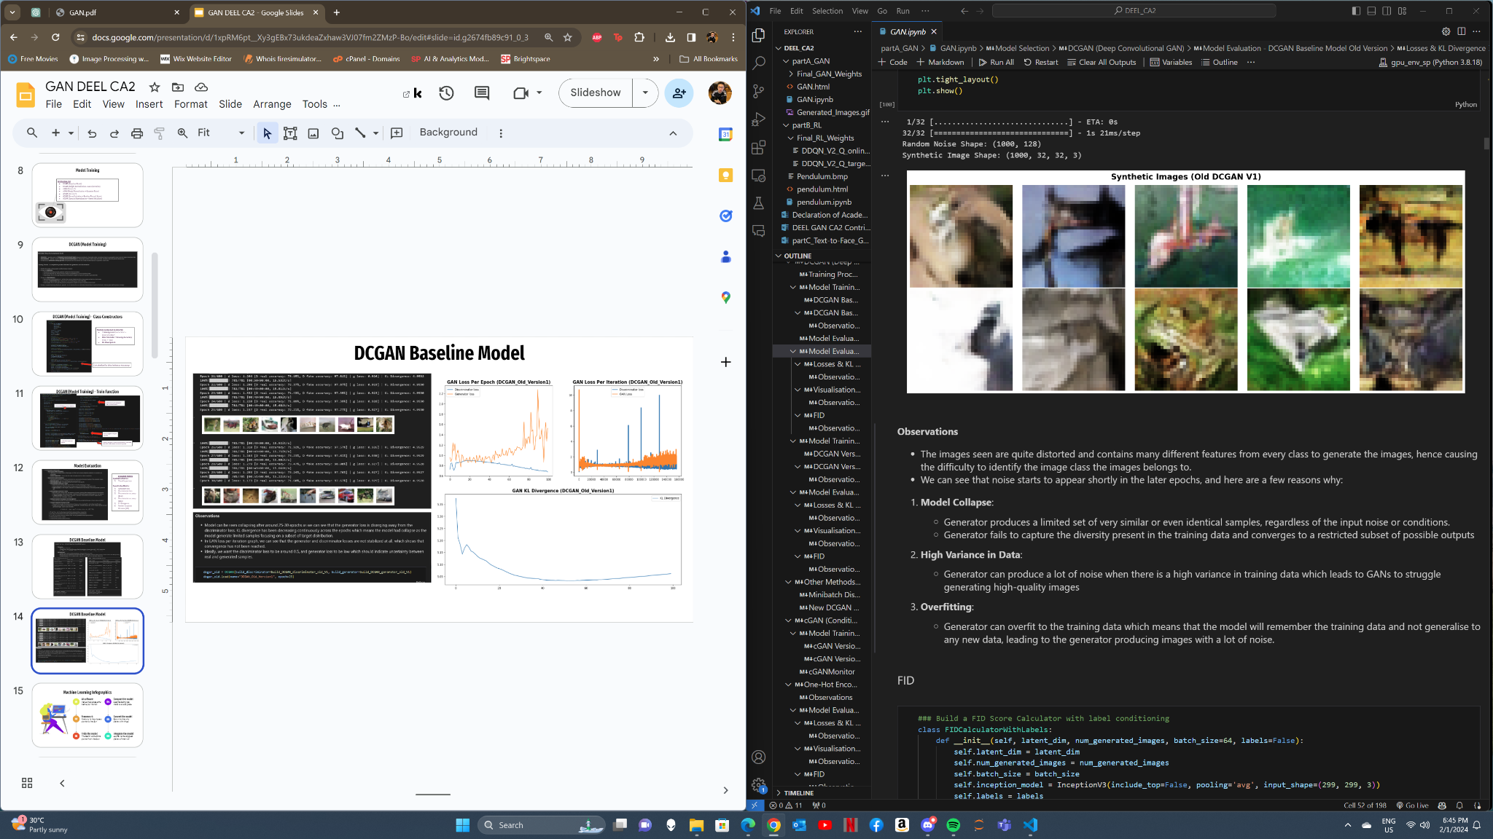
DCGAN Baseline Model (Visual Inspection)

Slide 16
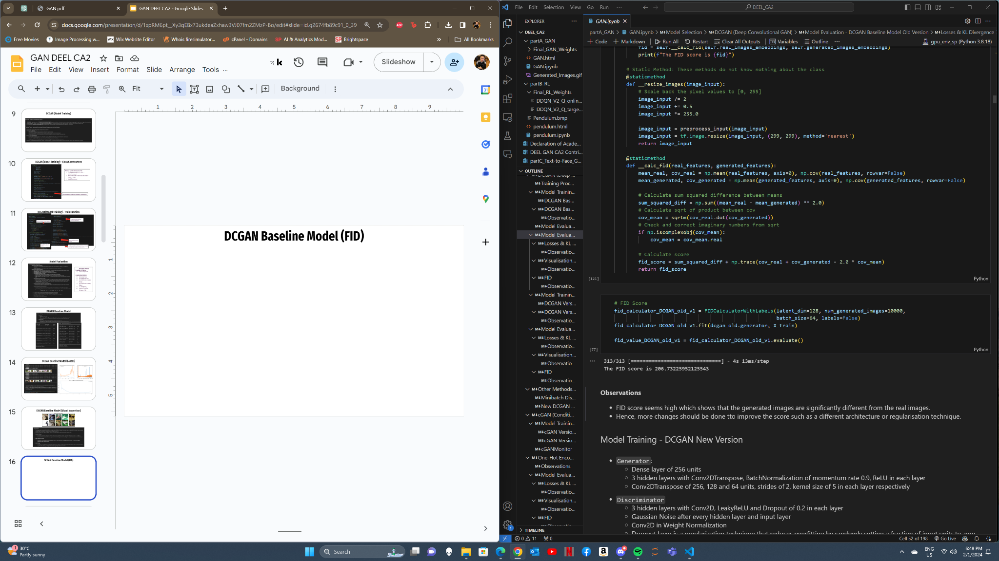
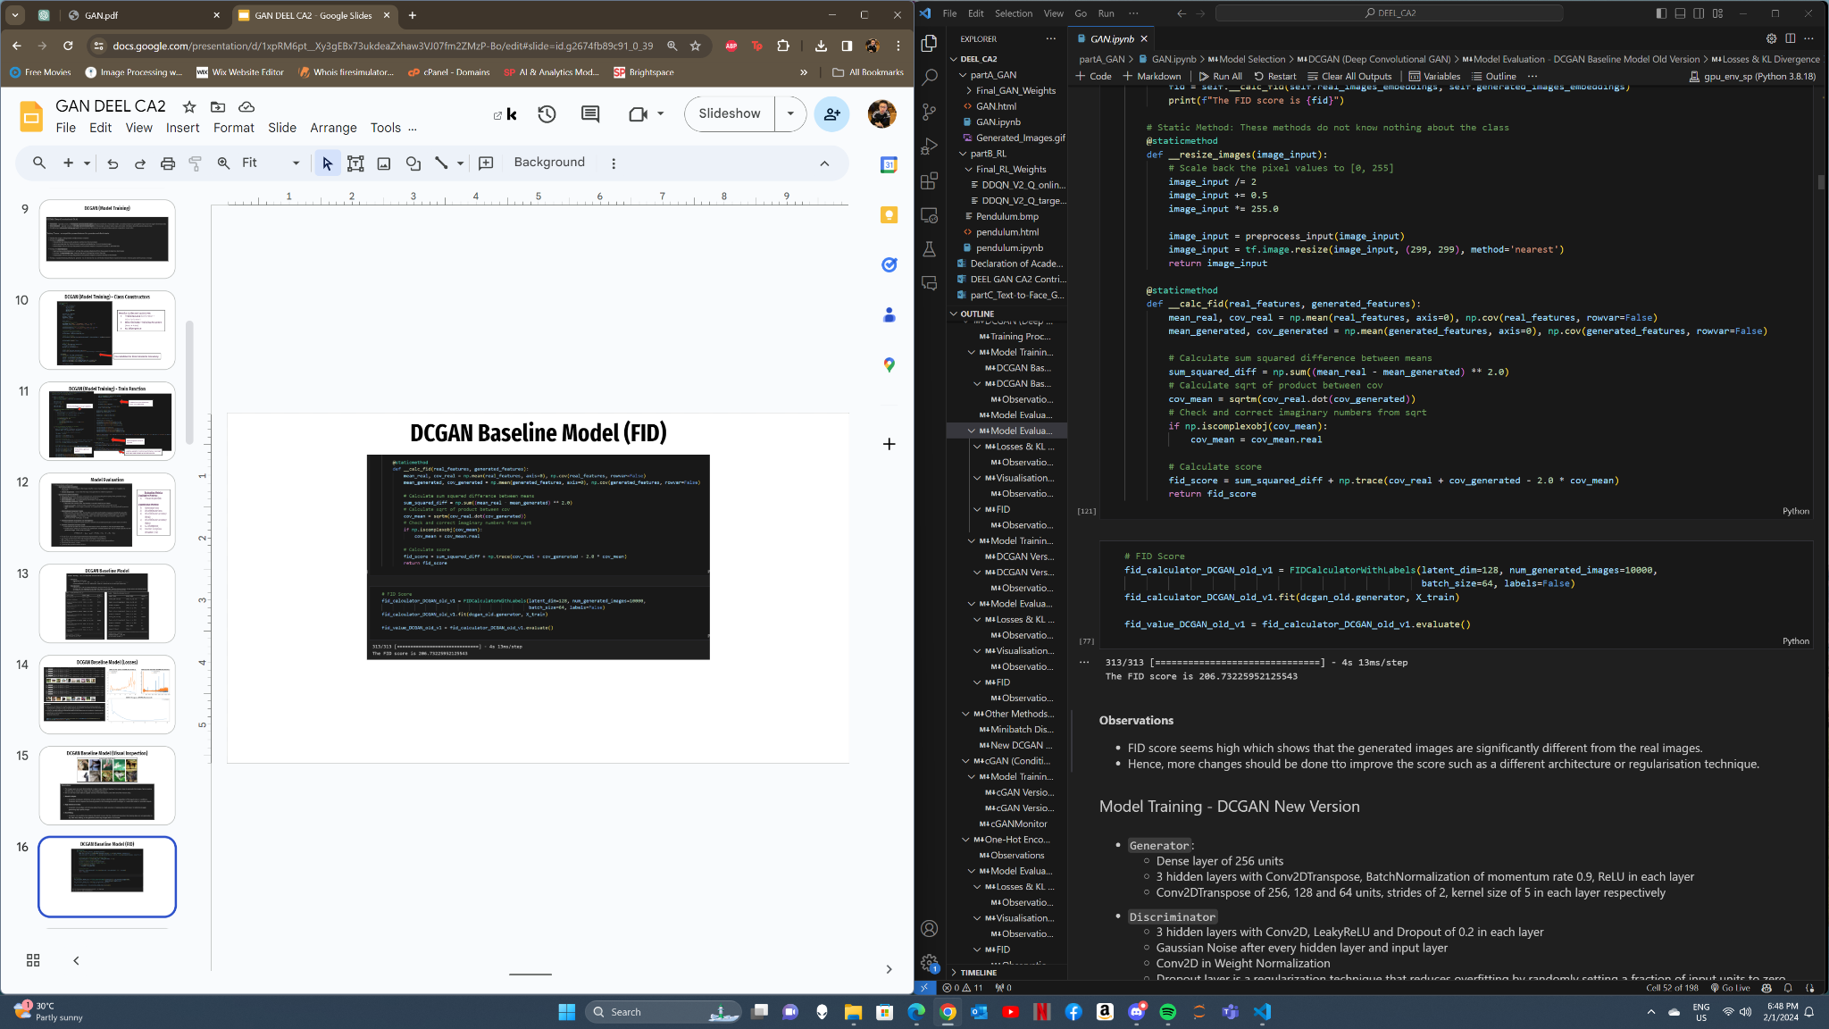
DCGAN Baseline Model (FID)

Slide 17
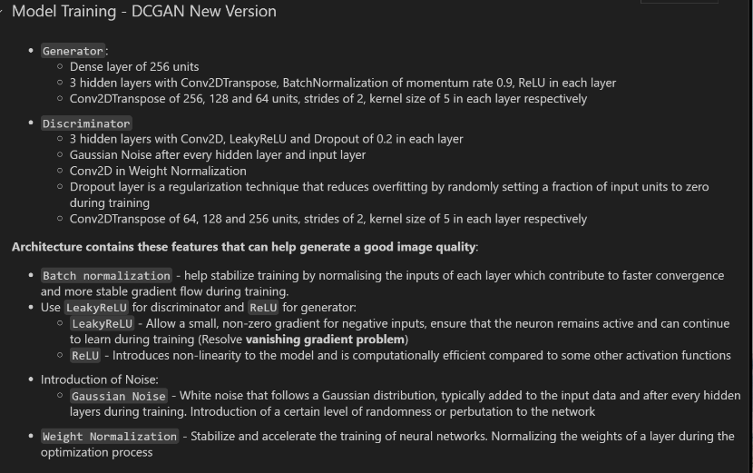
DCGAN New Version (Improved Baseline)

Slide 18
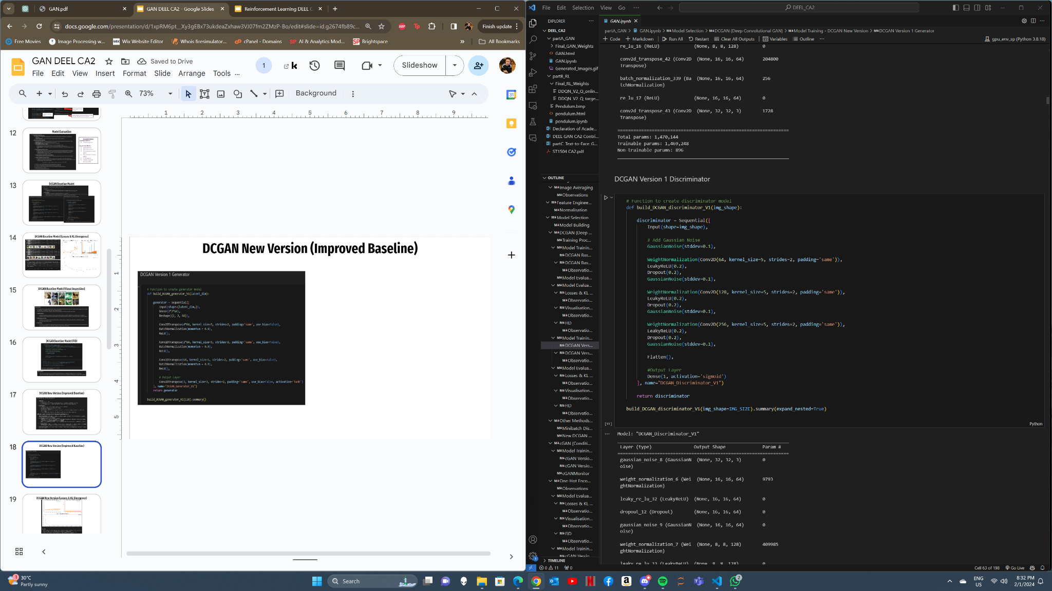
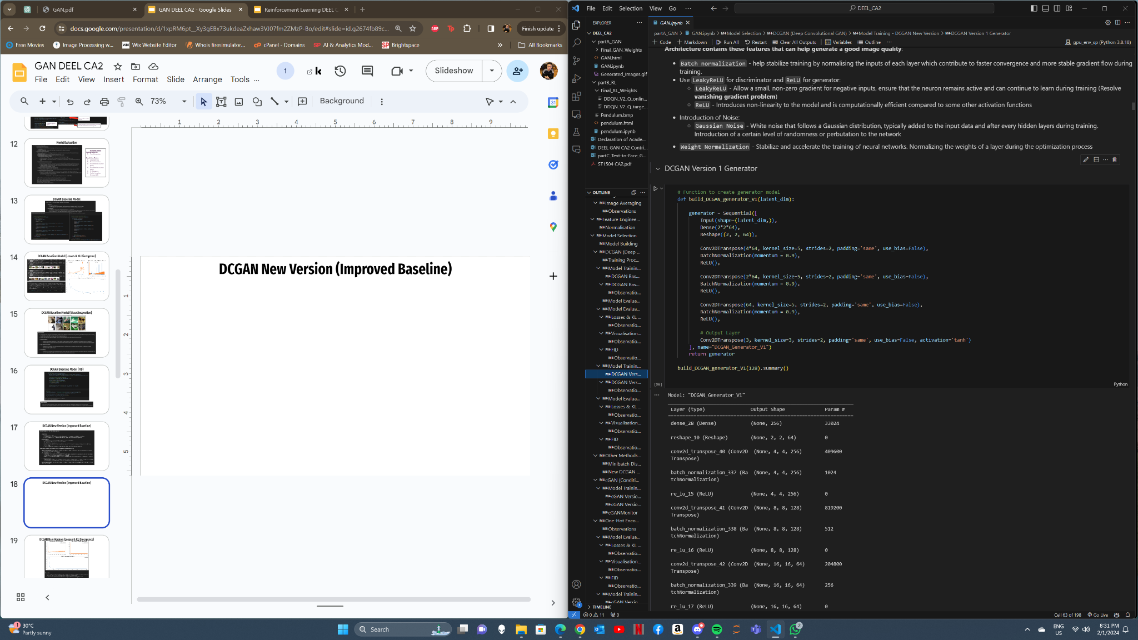
DCGAN New Version (Improved Baseline)

Slide 19
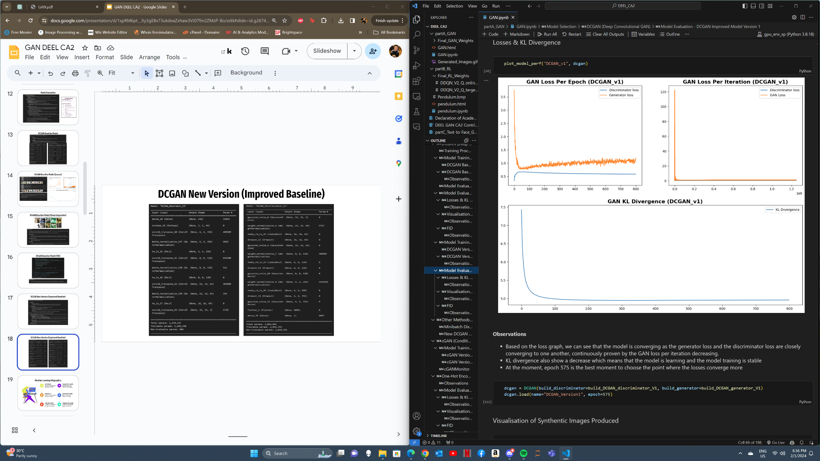
DCGAN New Version (Losses & KL Divergence)

Slide 20
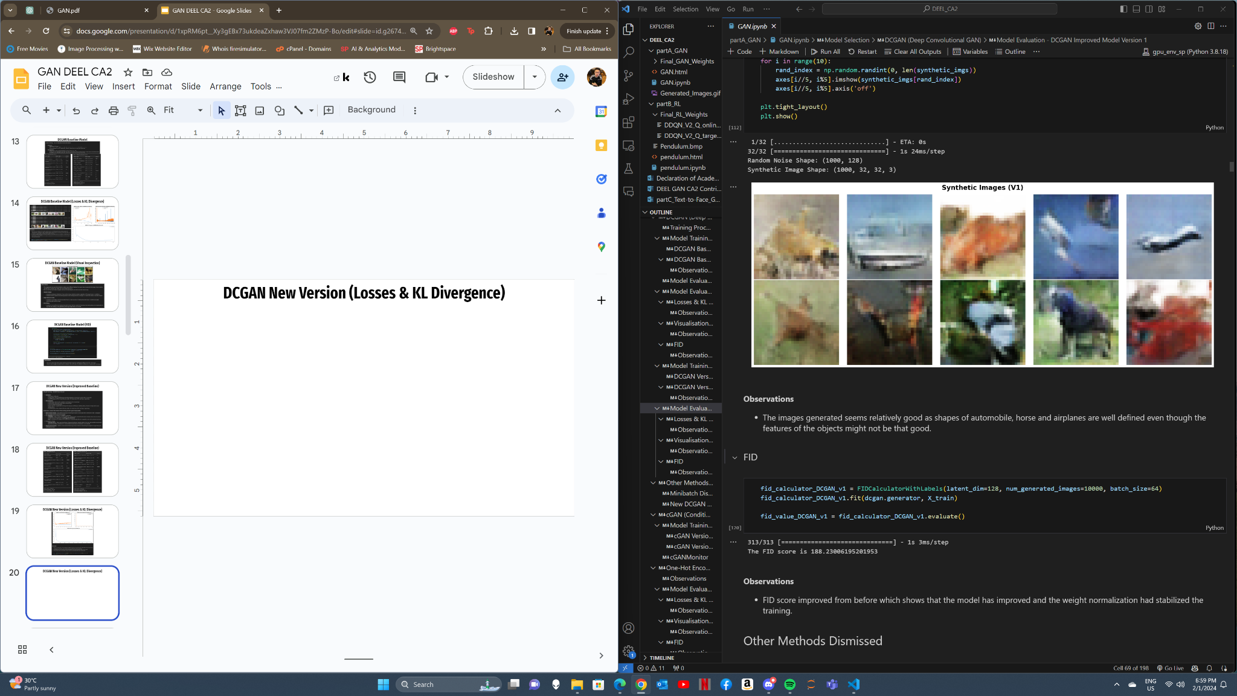
DCGAN New Version (Visual Inspection & FID)

Slide 21

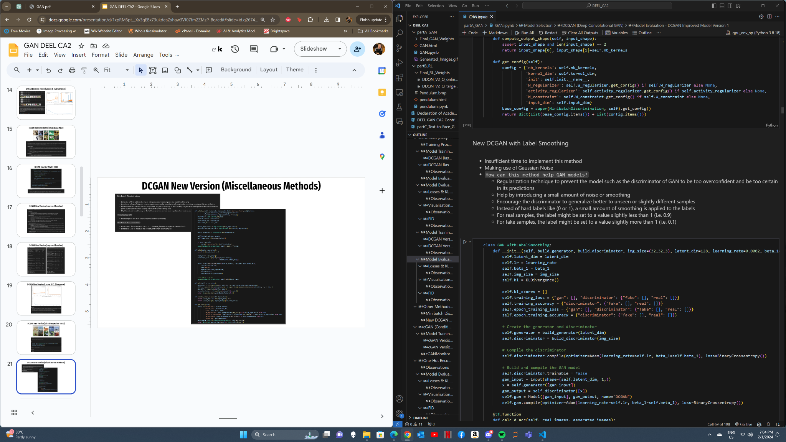
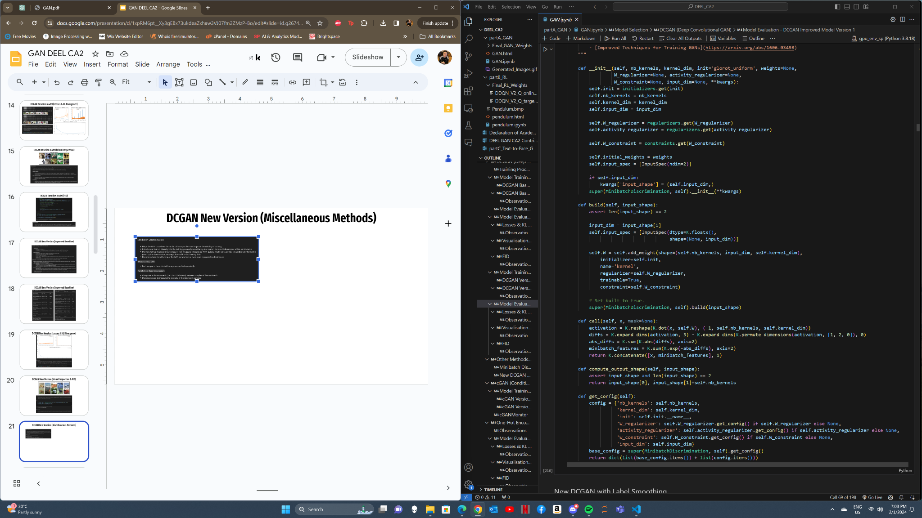
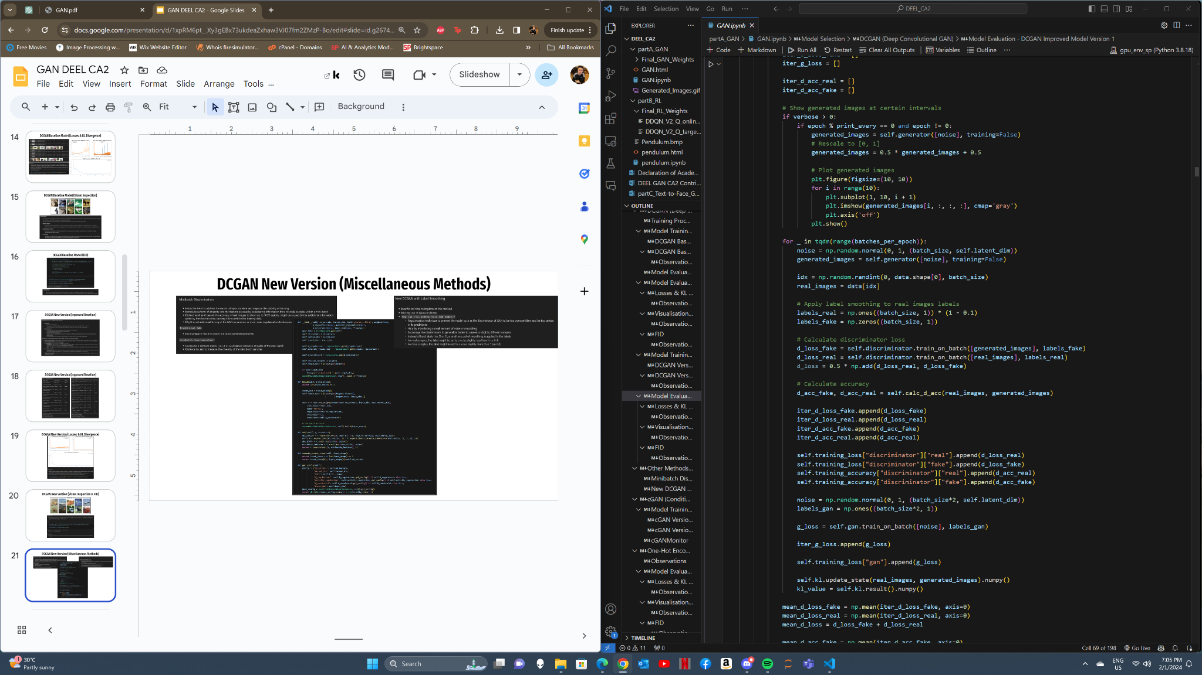
DCGAN New Version (Miscellaneous Methods)
Methods:
Minibatch Discrimination
Label Smoothing

Slide 22
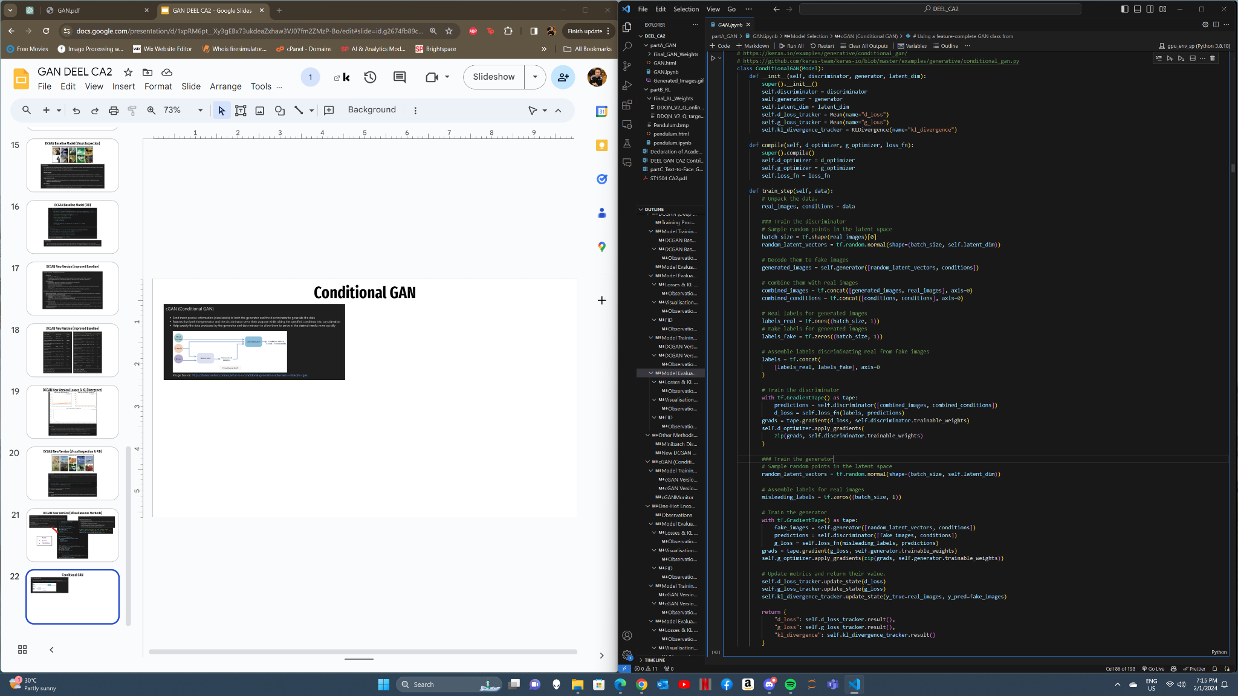
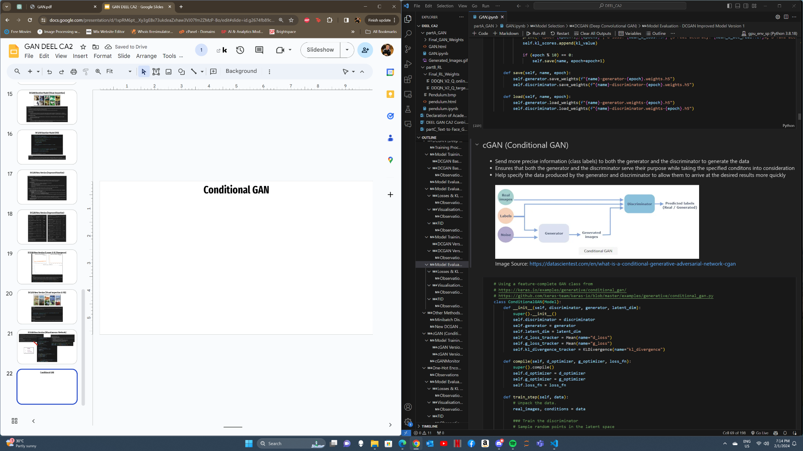
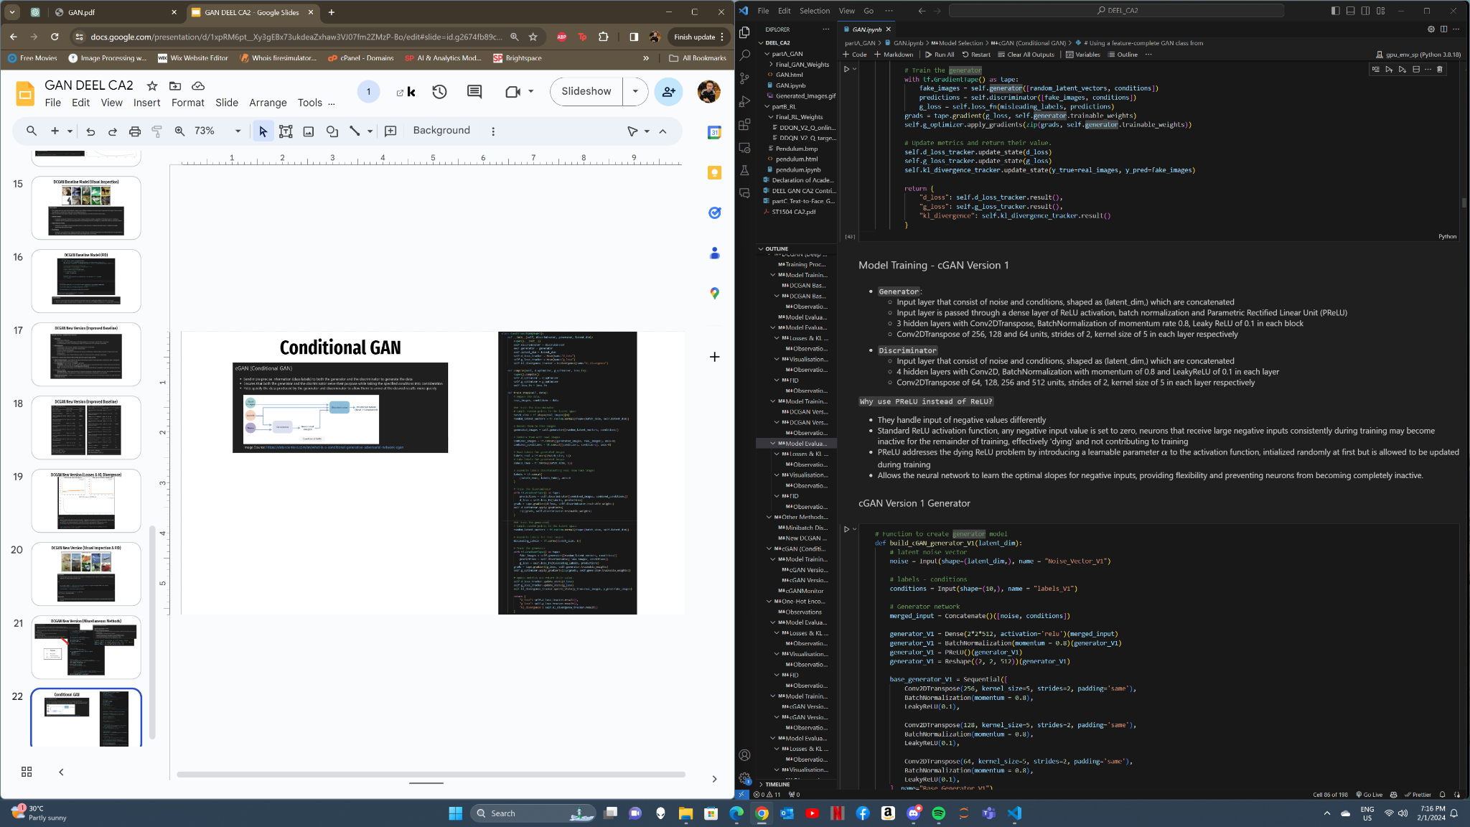
Conditional GAN
Include conditions to allow model to include features into consideration while generating images
Using PReLU in cGAN

Slide 23
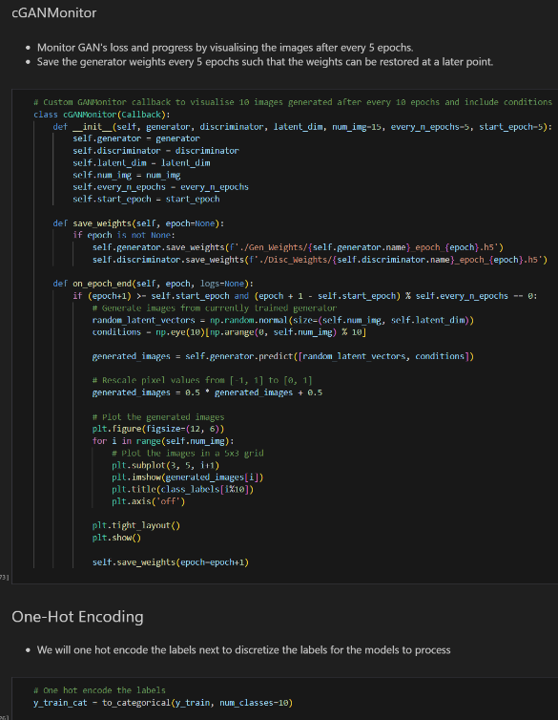
cGANMonitor + One Hot Encode y_train

Slide 24
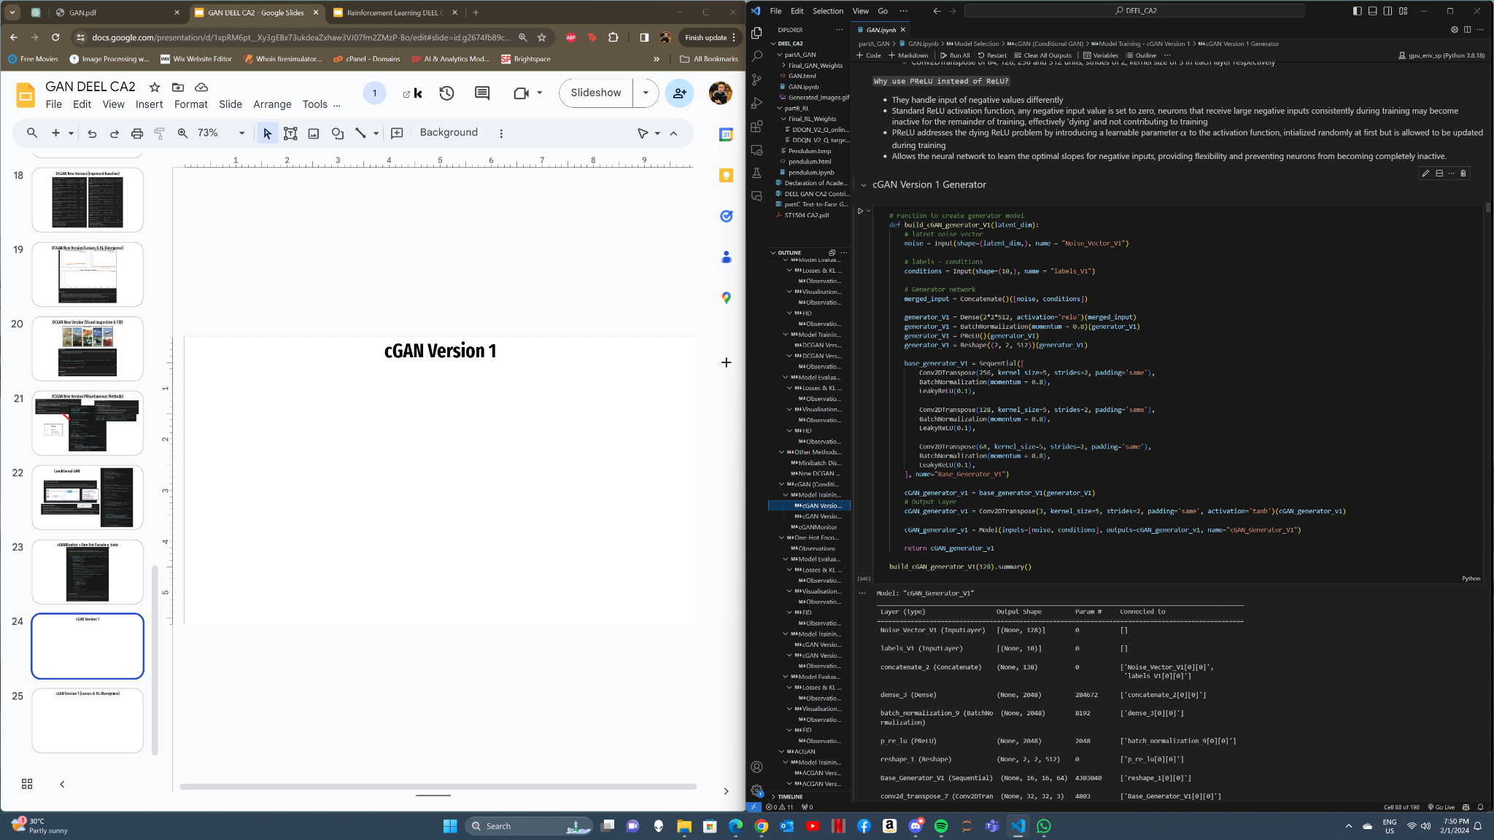
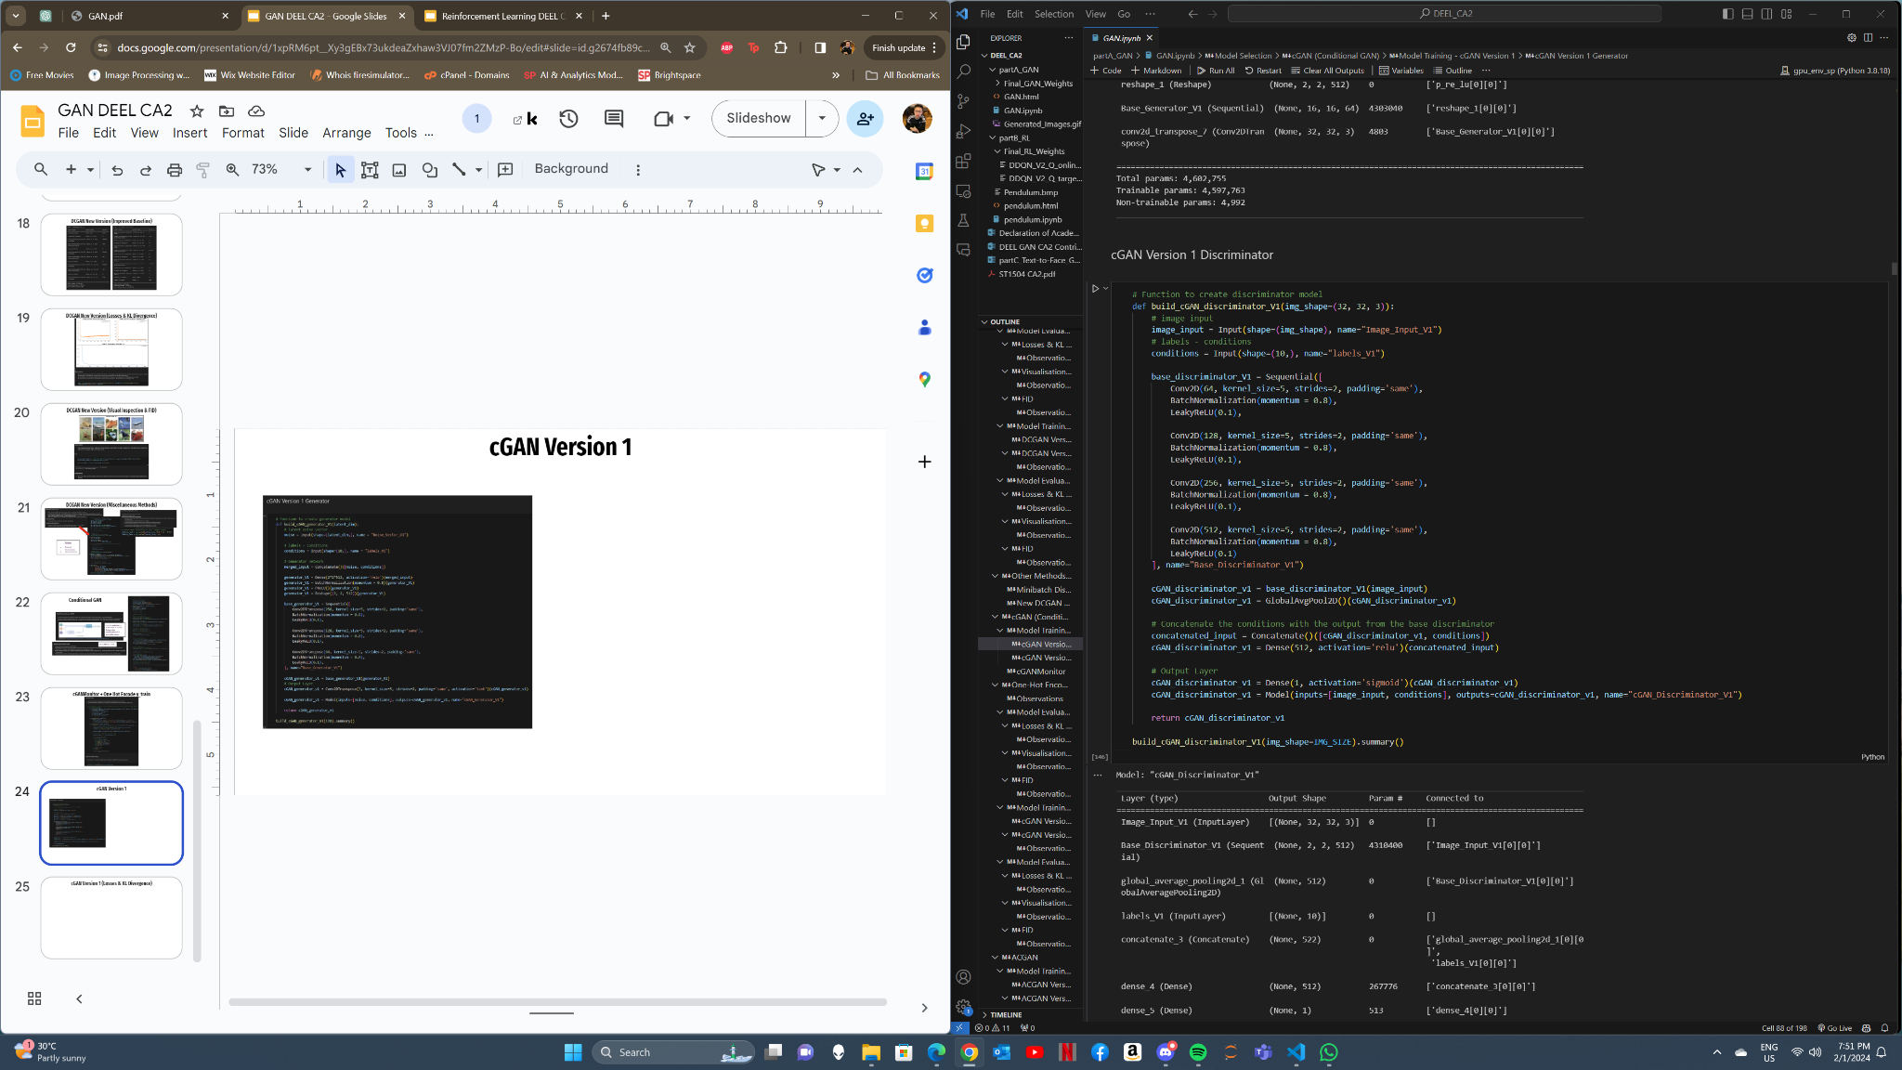
cGAN Version 1

Slide 25
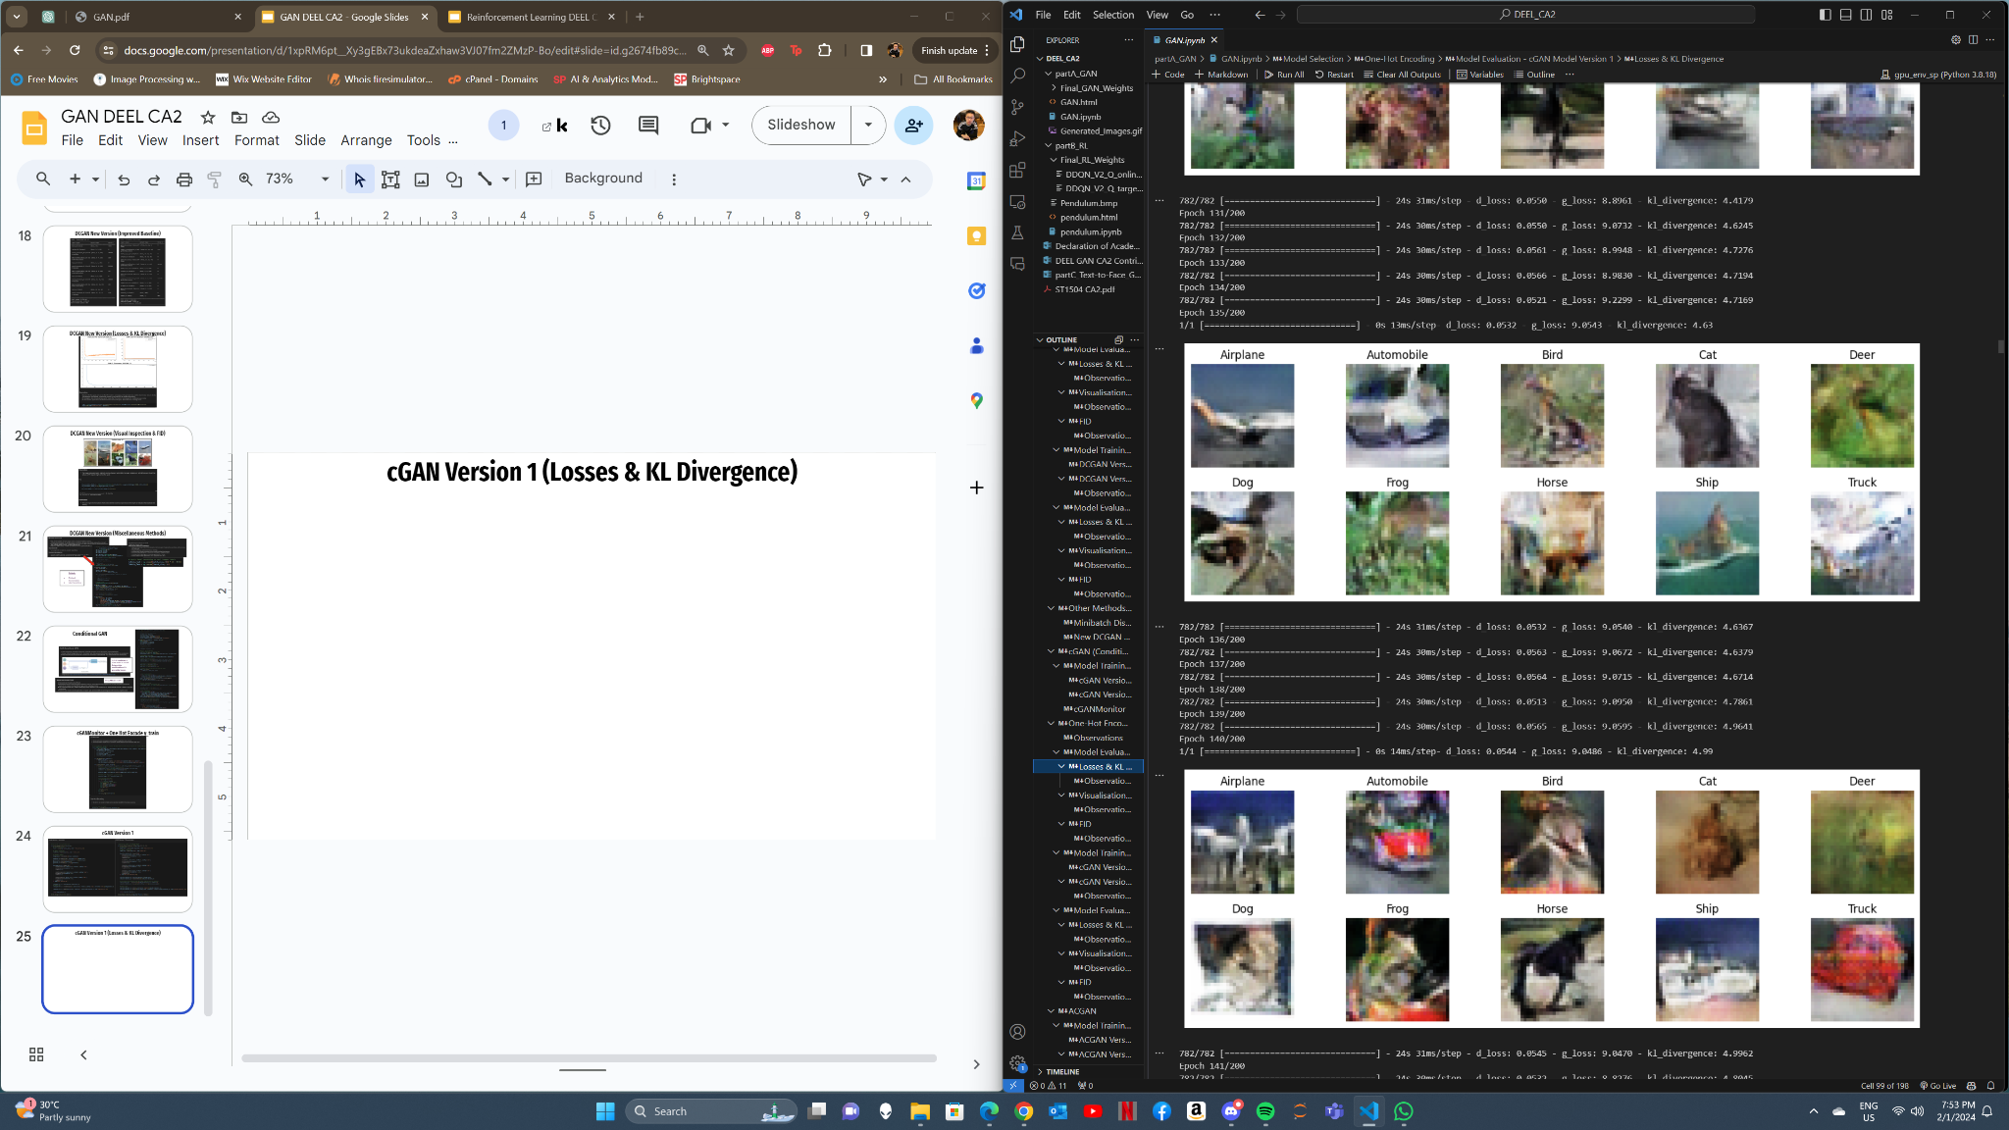
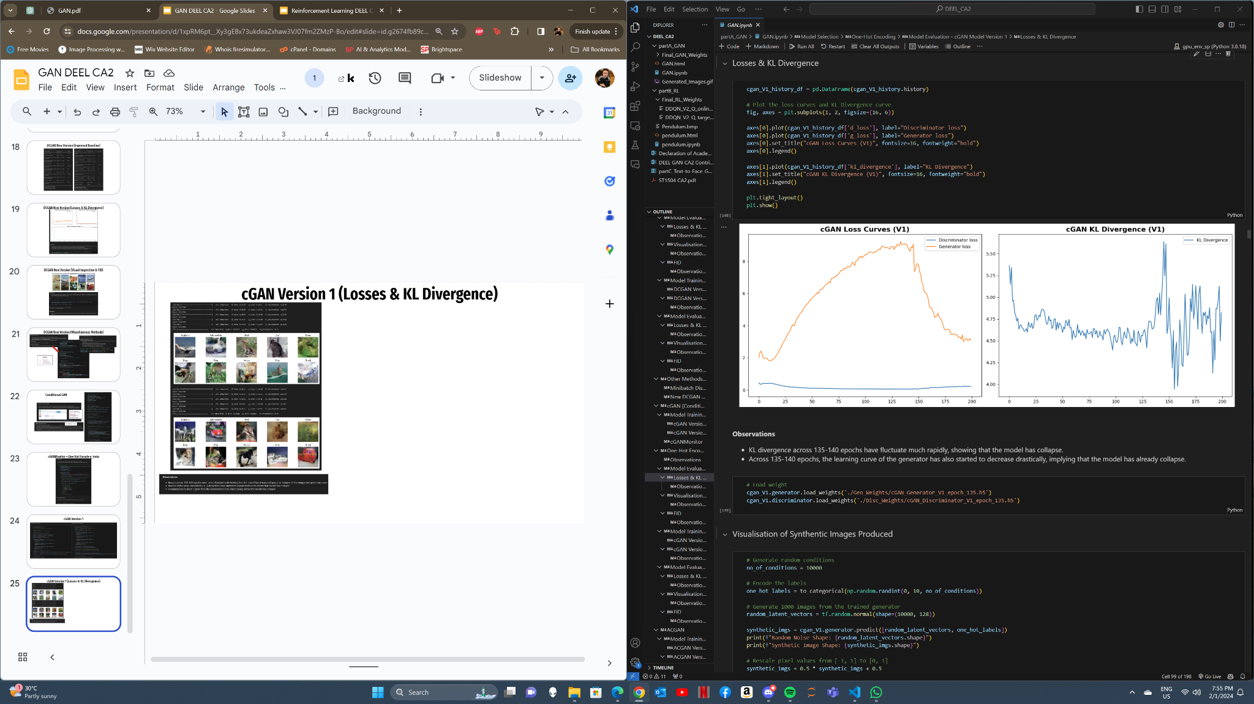
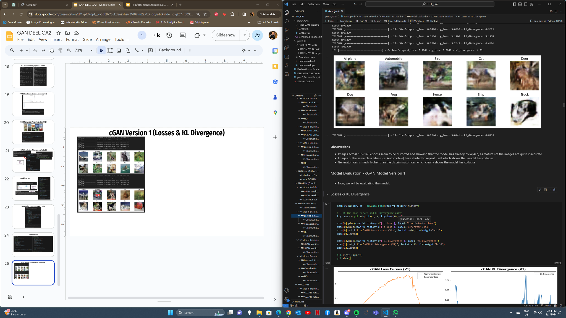
cGAN Version 1 (Losses & KL Divergence)

Slide 26
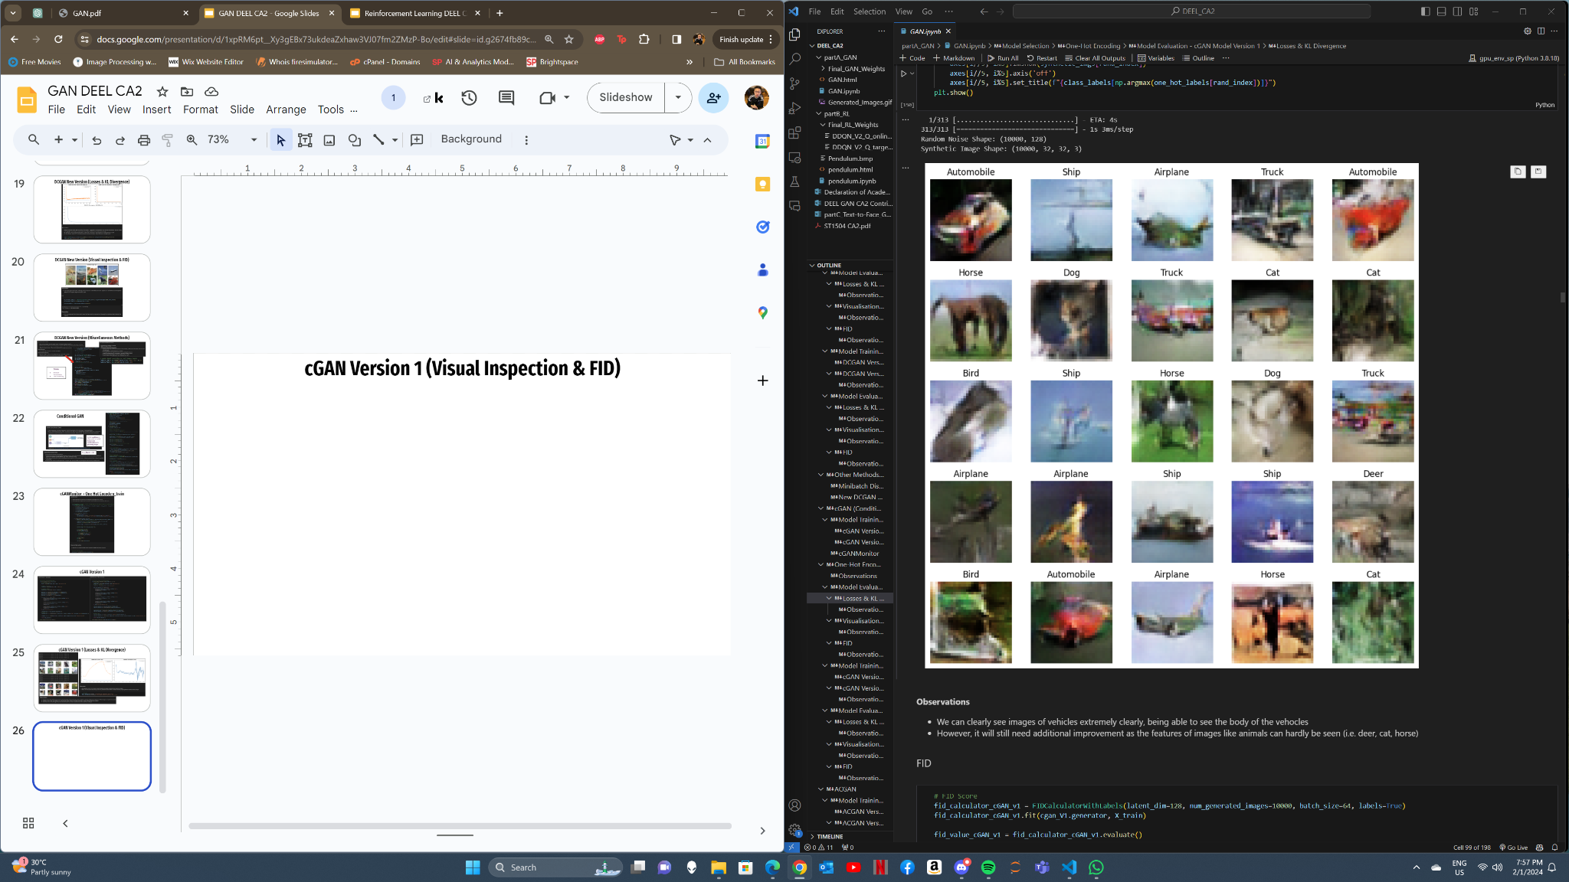
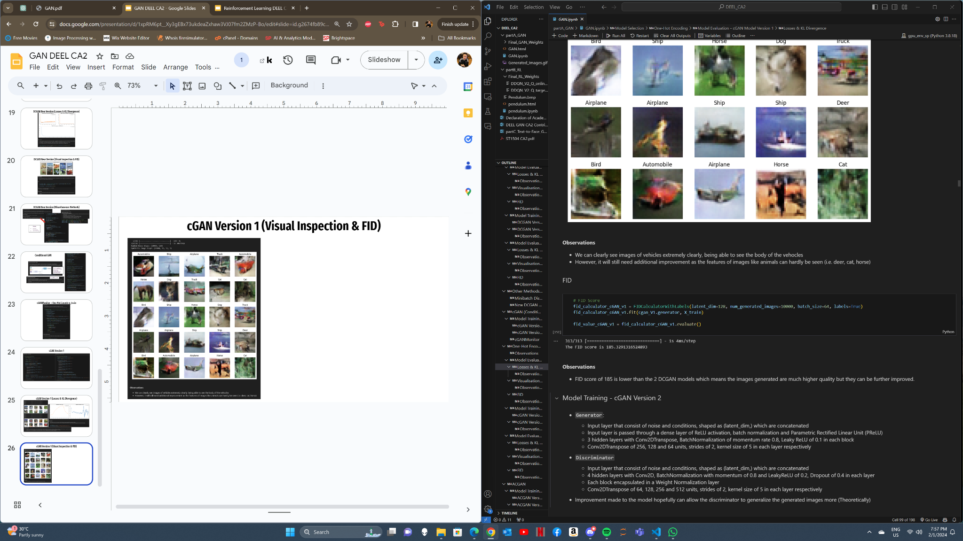
cGAN Version 1 (Visual Inspection & FID)

Slide 27
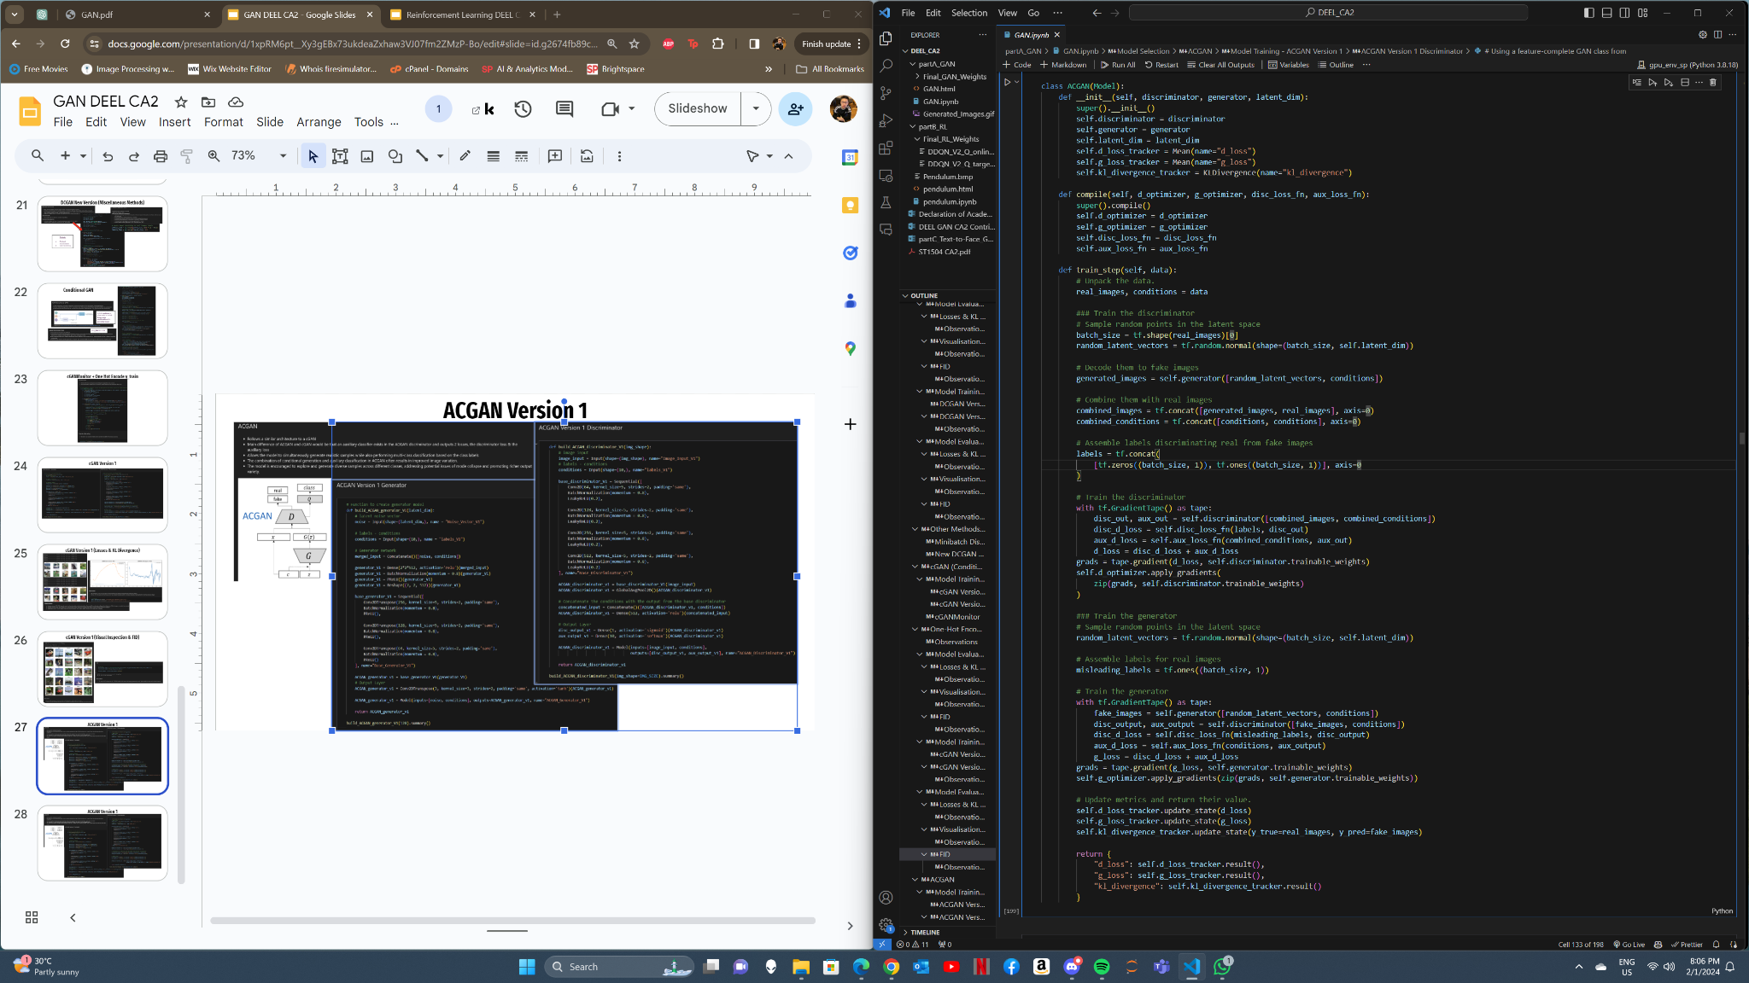
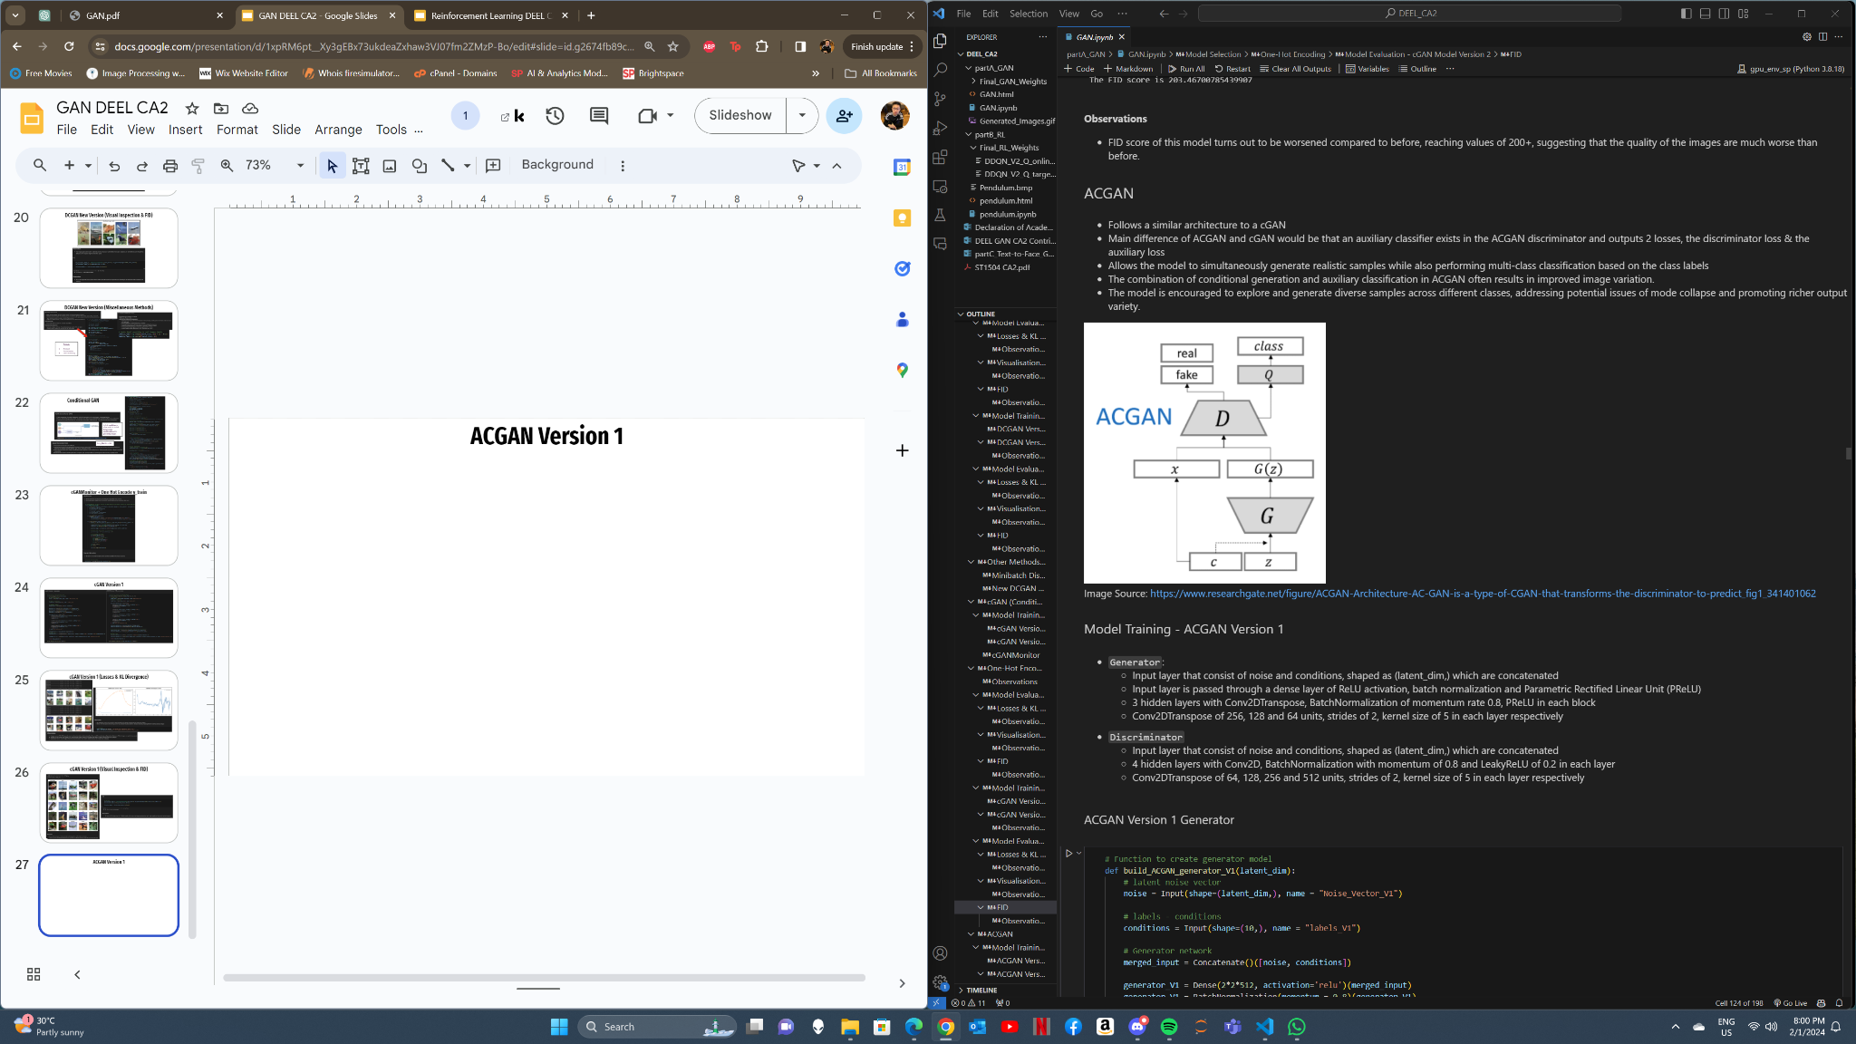
ACGAN
Auxiliary Classifier in Discriminator Outputs 2 Losses:
Discriminator loss
Auxiliary loss

Slide 28
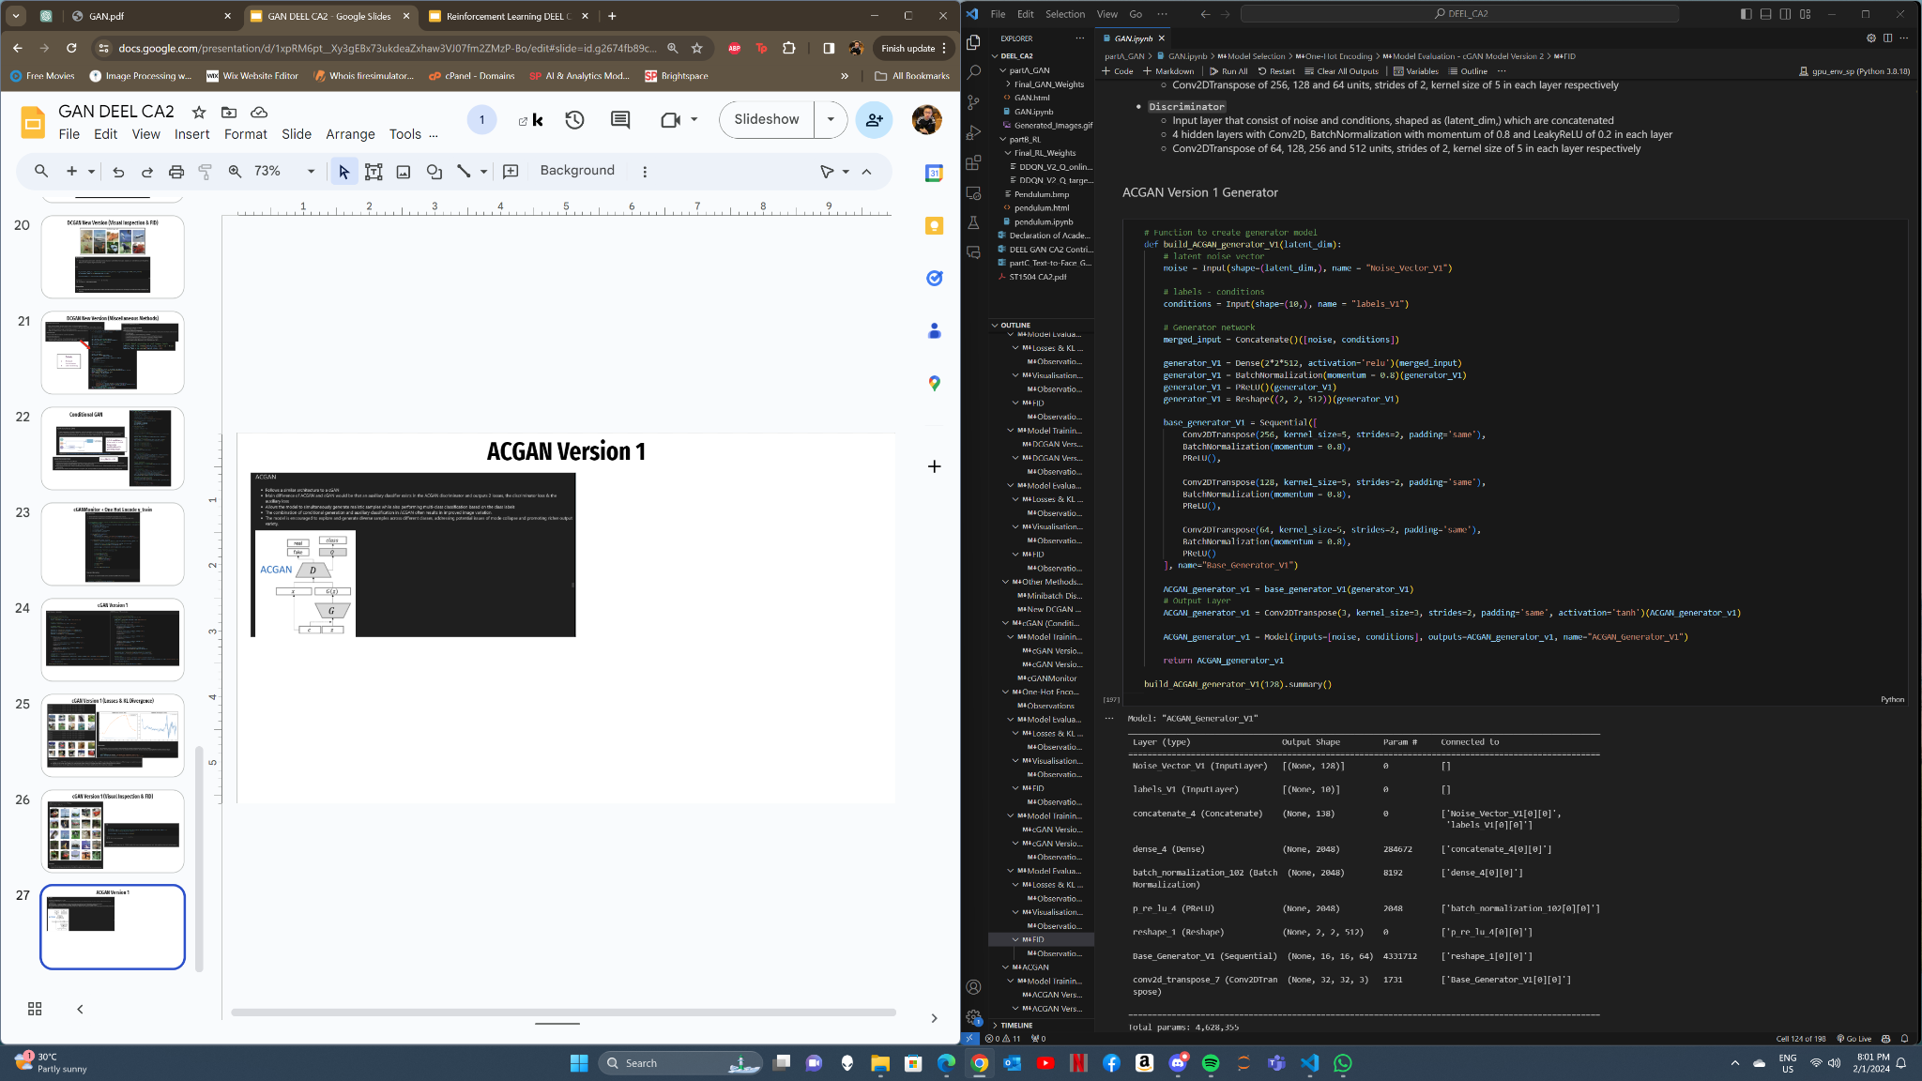
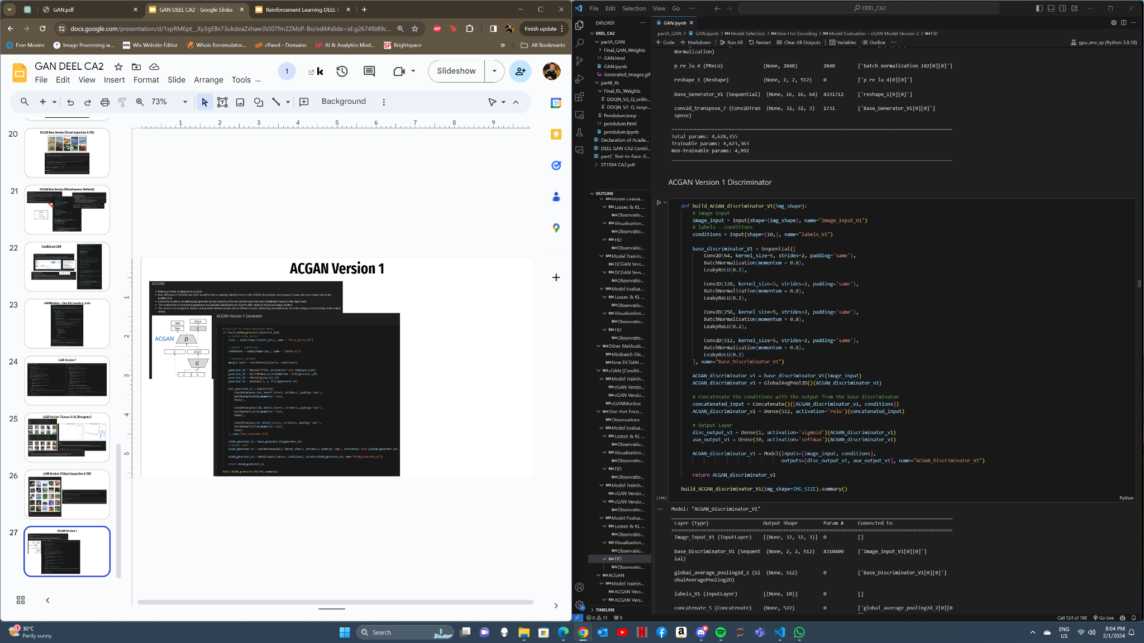
ACGAN Version 1

Slide 29
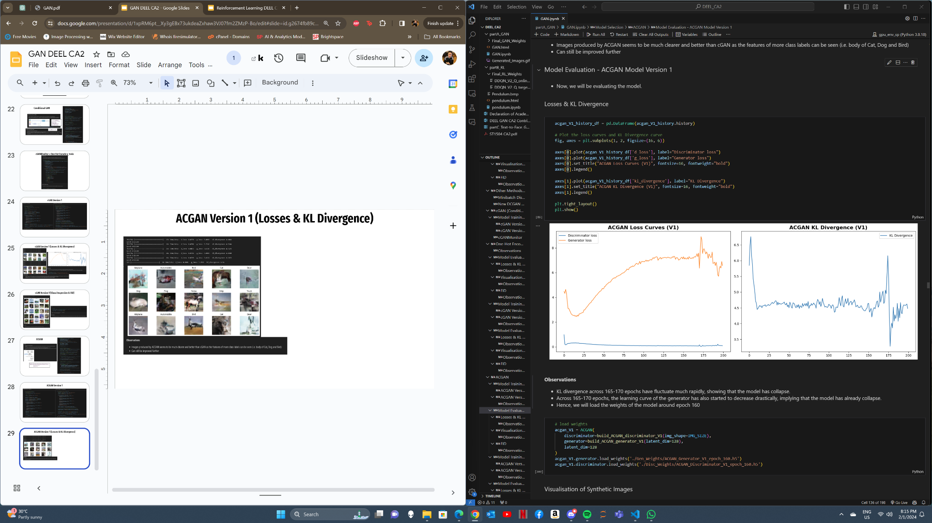
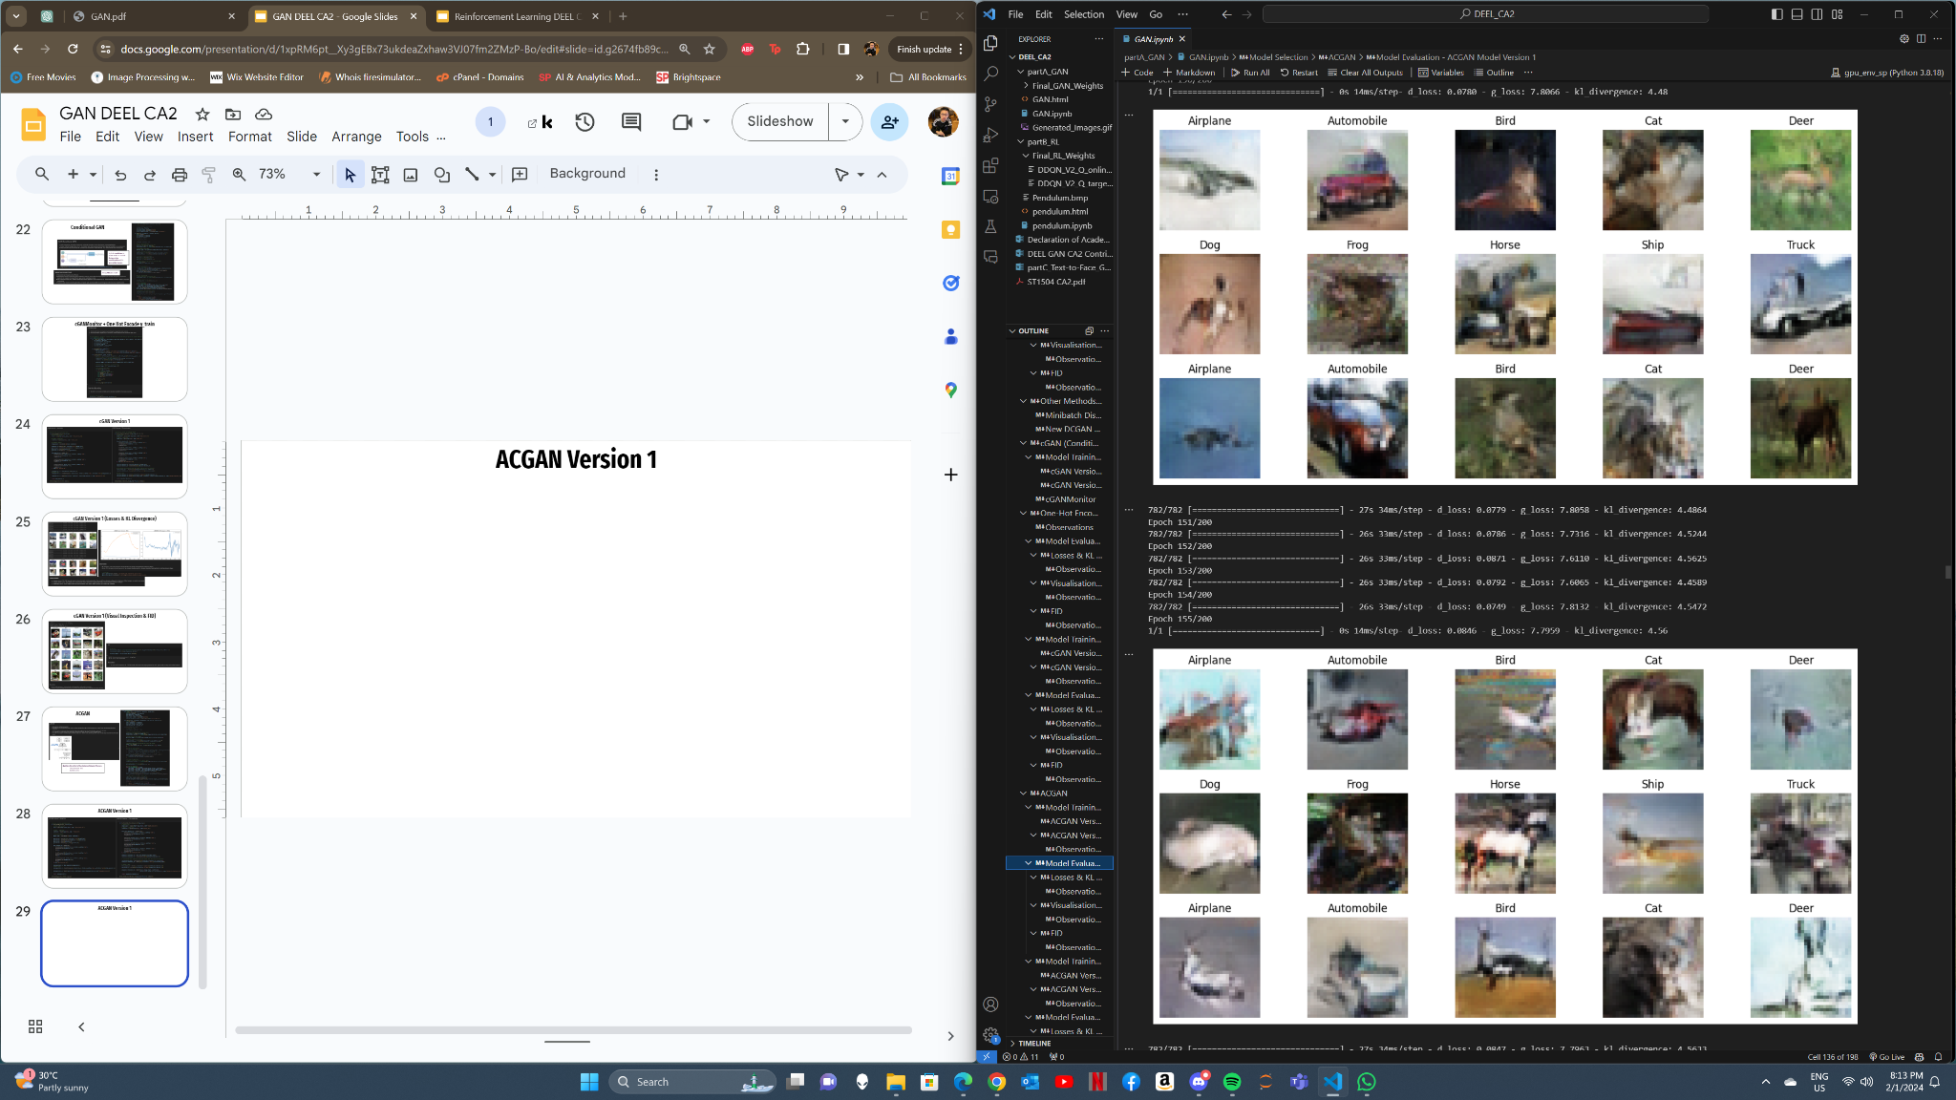
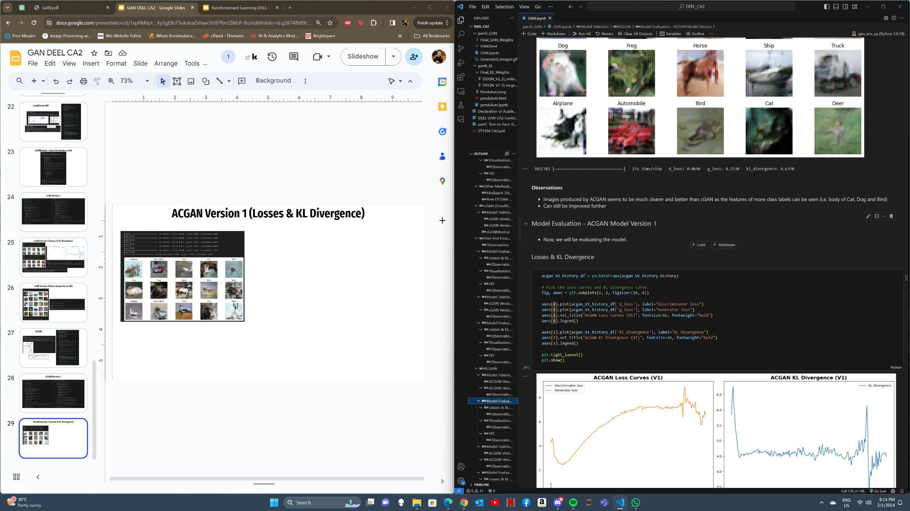
ACGAN Version 1 (Losses & KL Divergence)

Slide 30
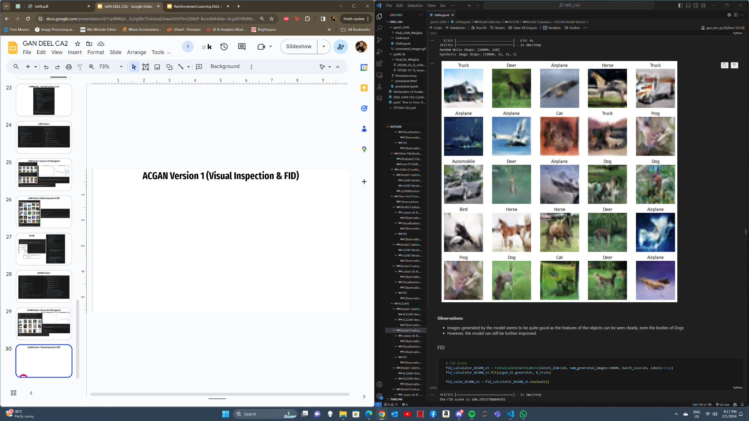
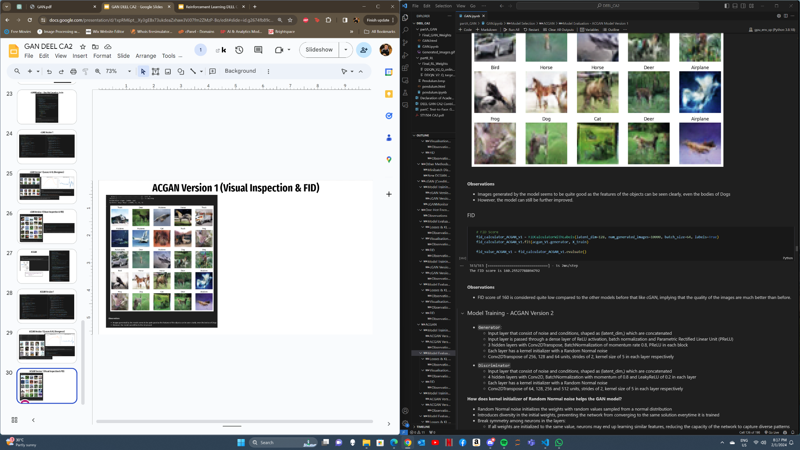
ACGAN Version 1 (Visual Inspection & FID)

Slide 31
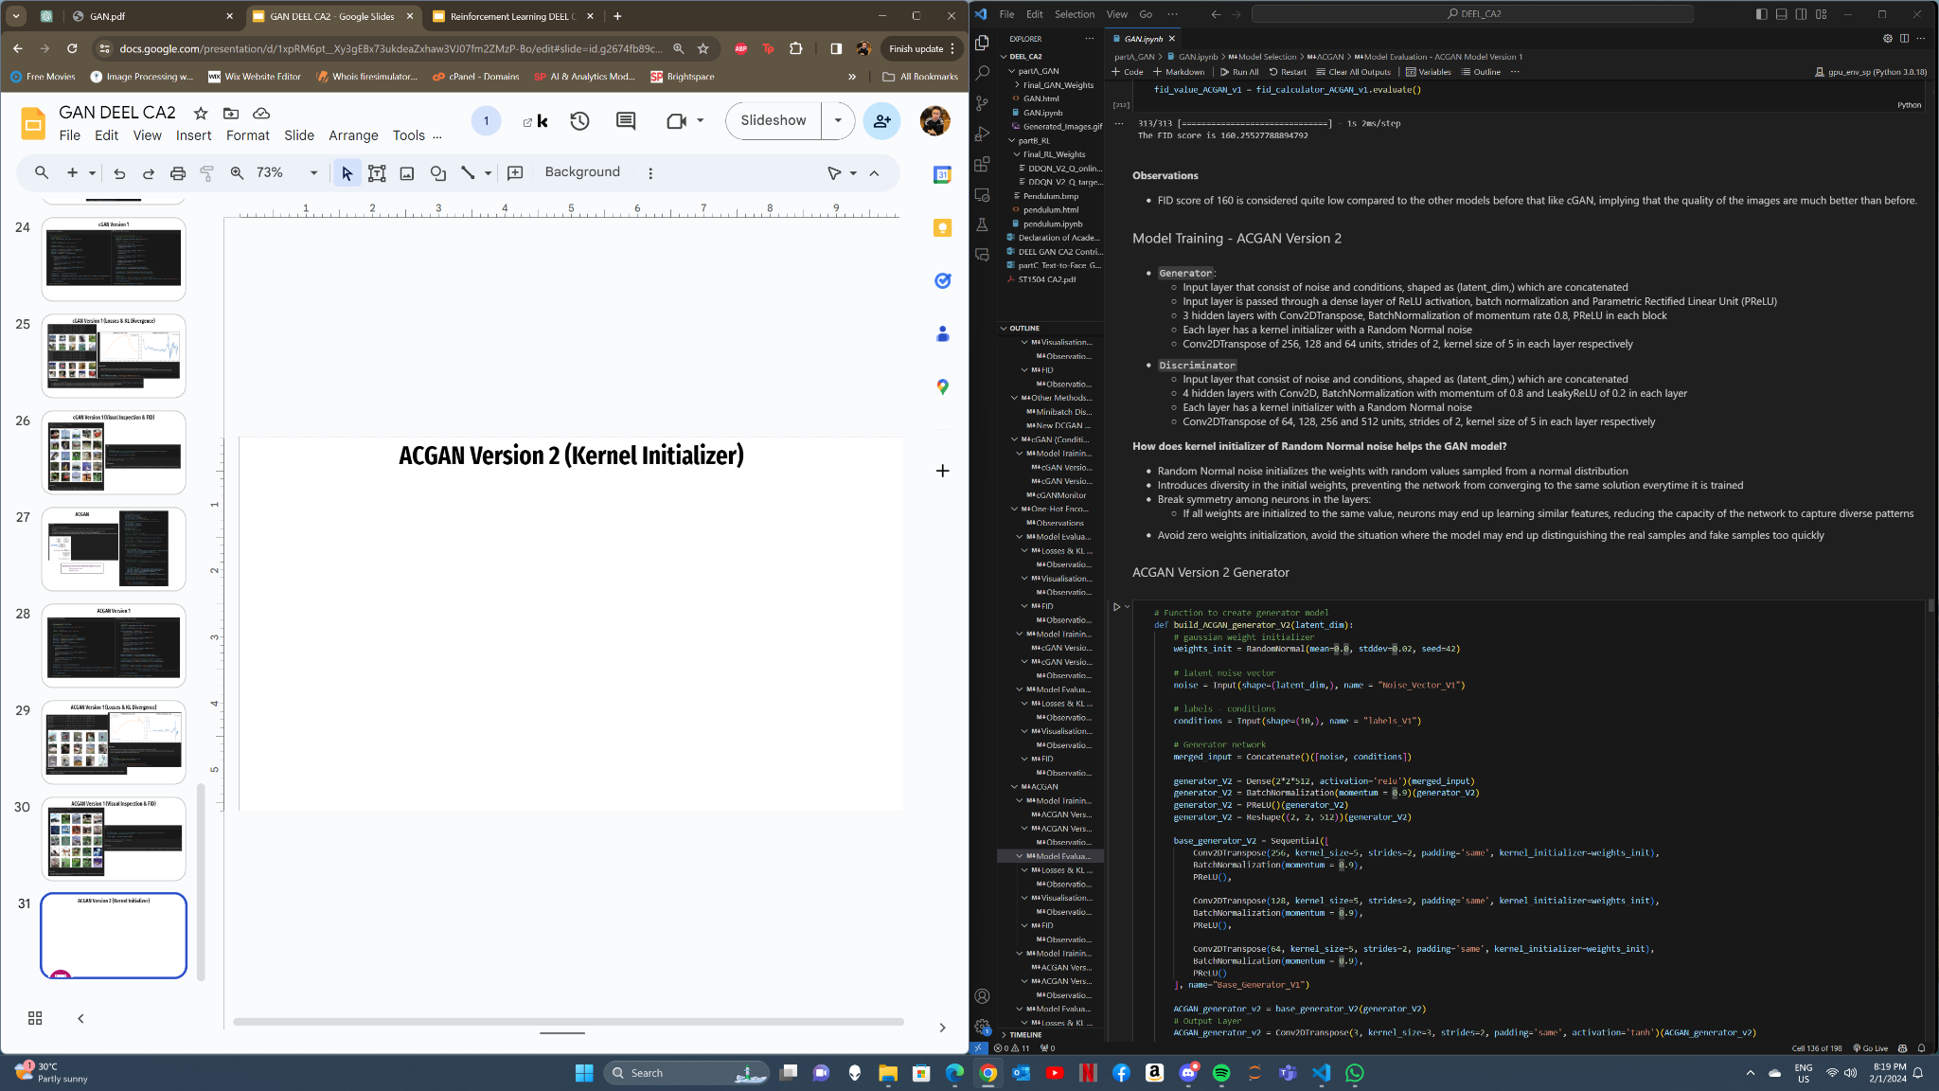
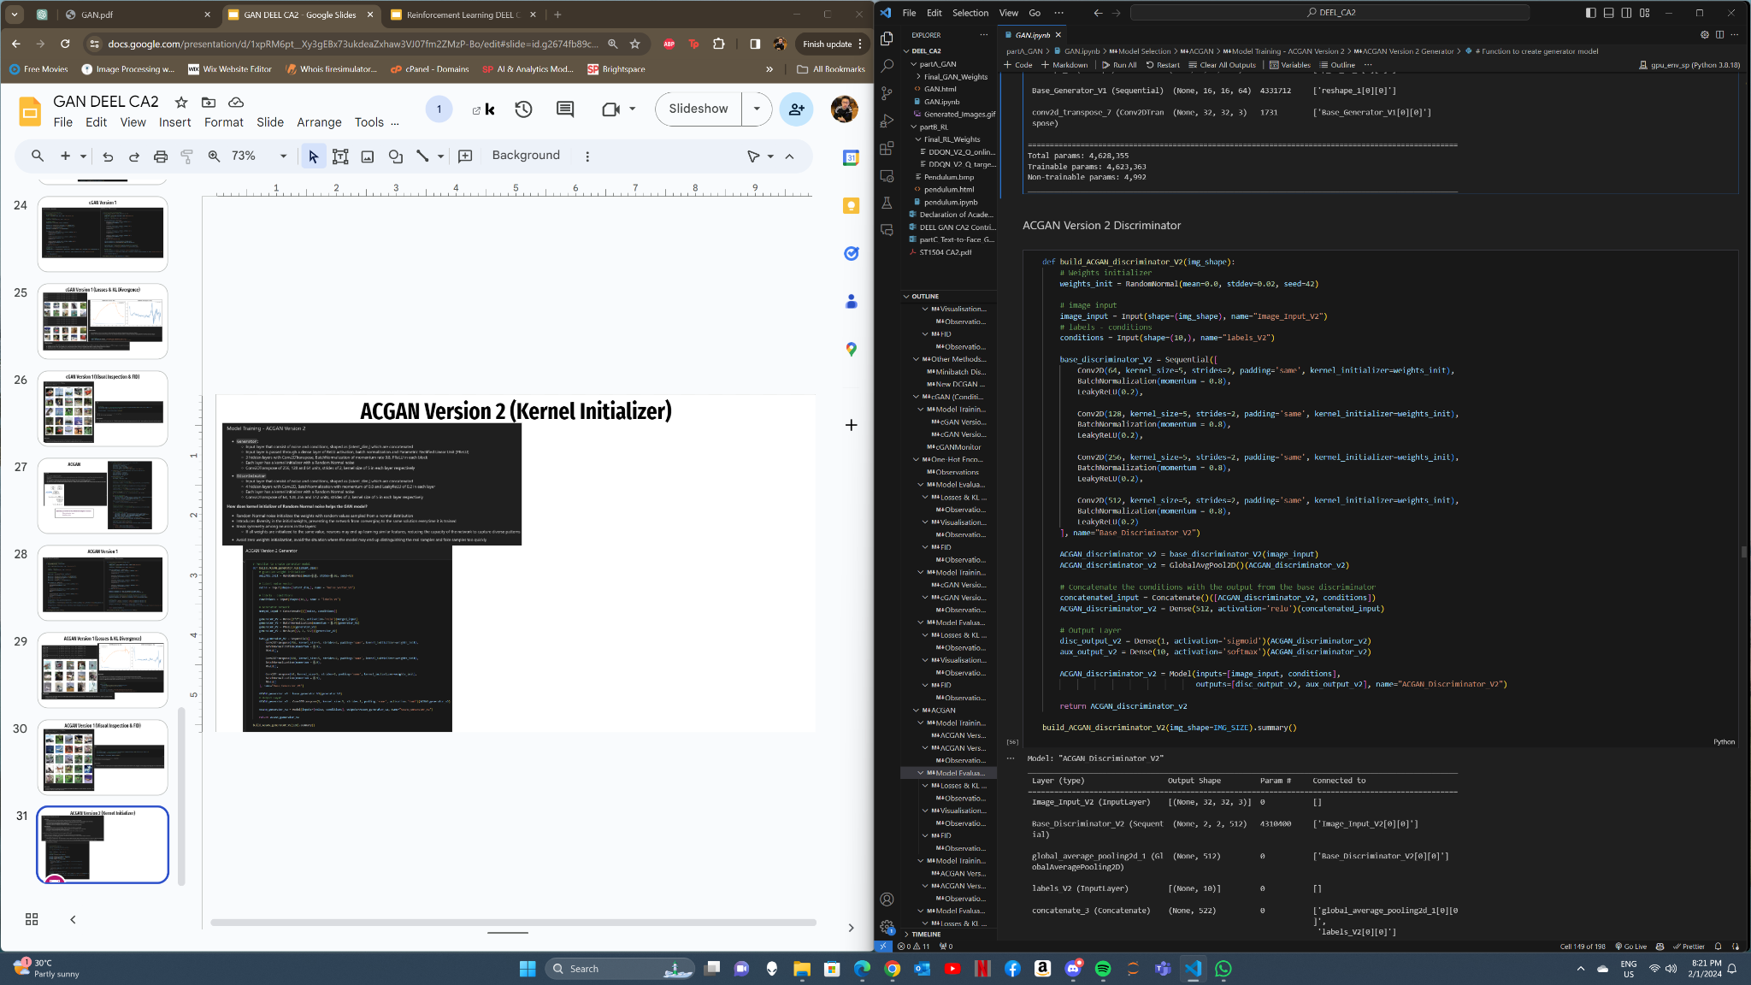
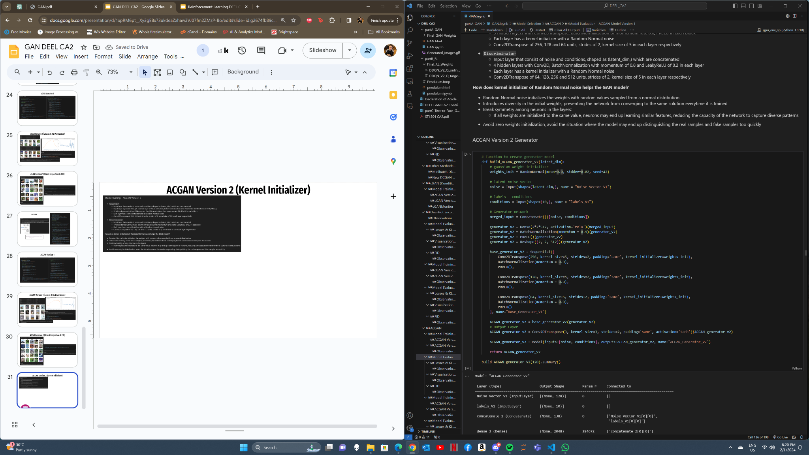
ACGAN Version 2 (Kernel Initializer)
ACGAN V2 Discriminator with Random Normal noise in kernel initializer
ACGAN V2 Generator

Slide 32
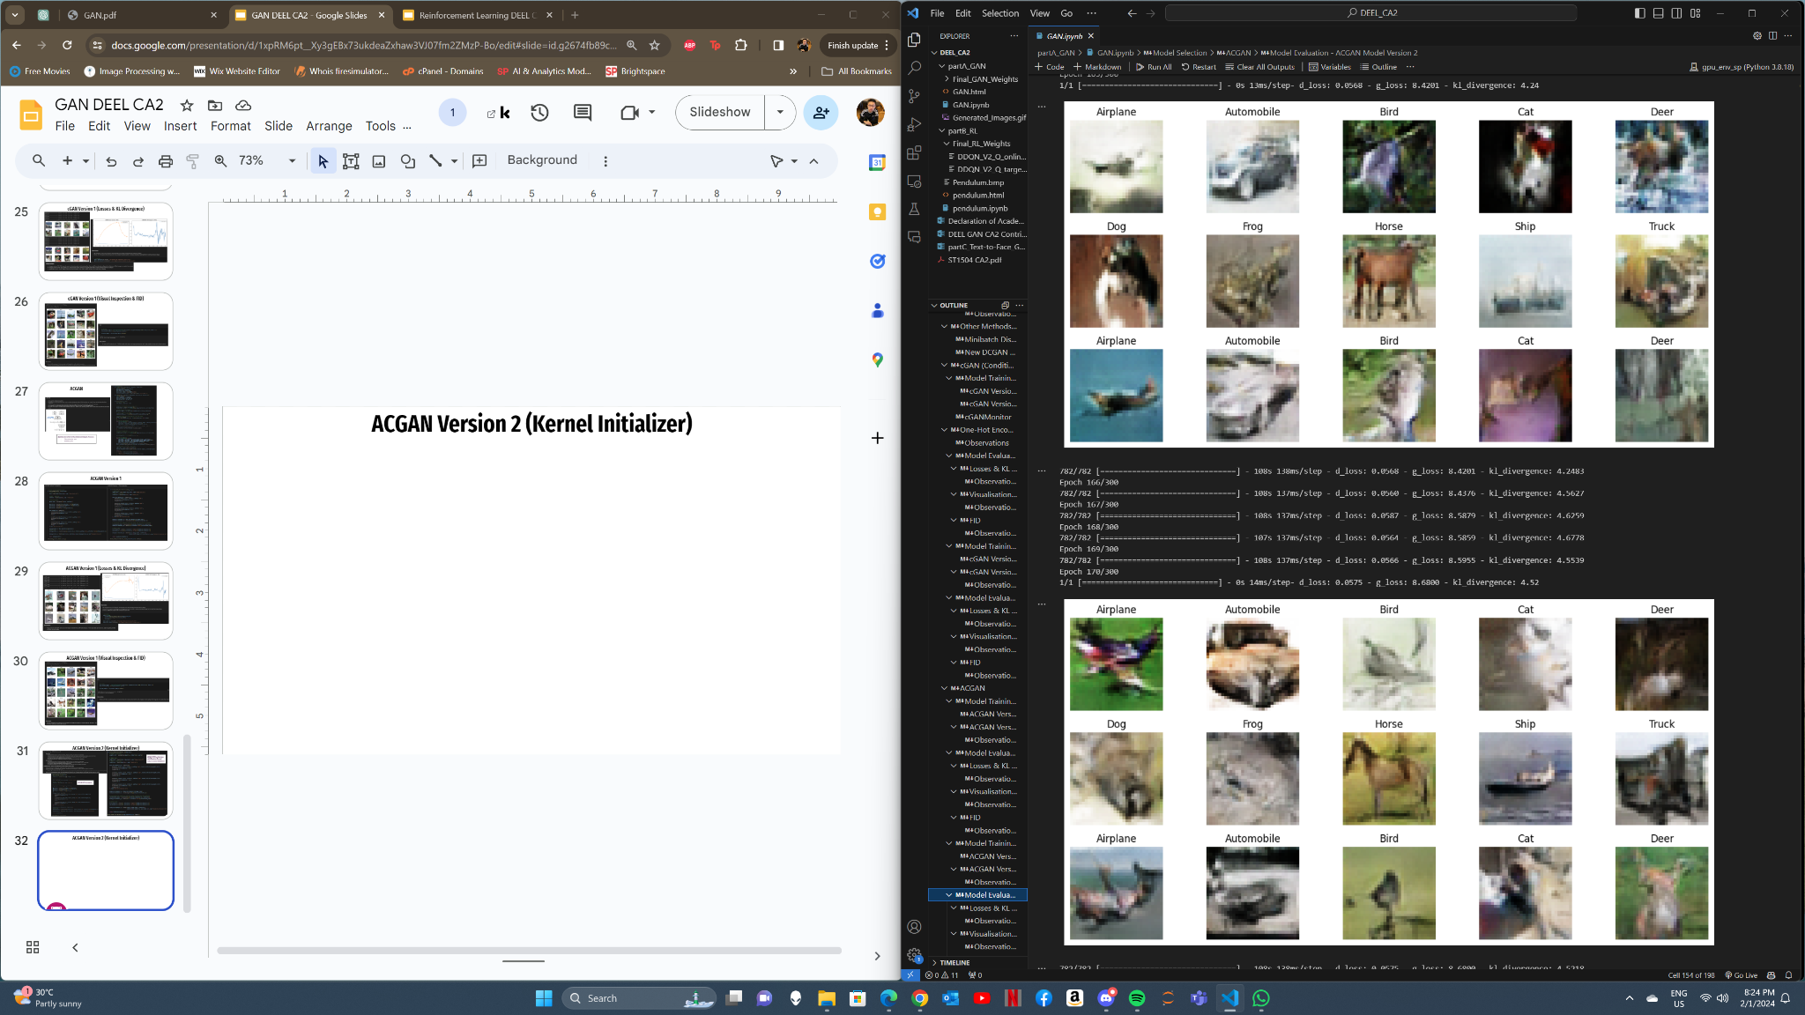
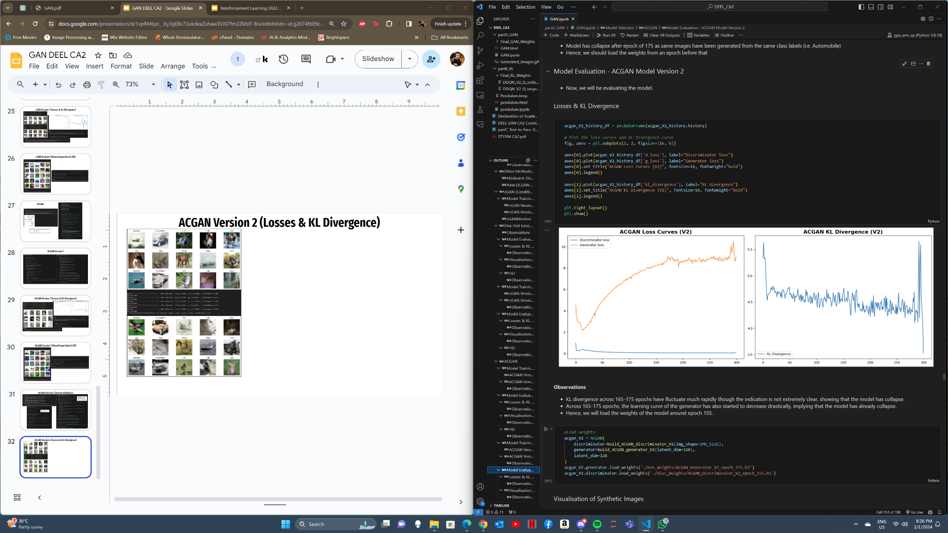
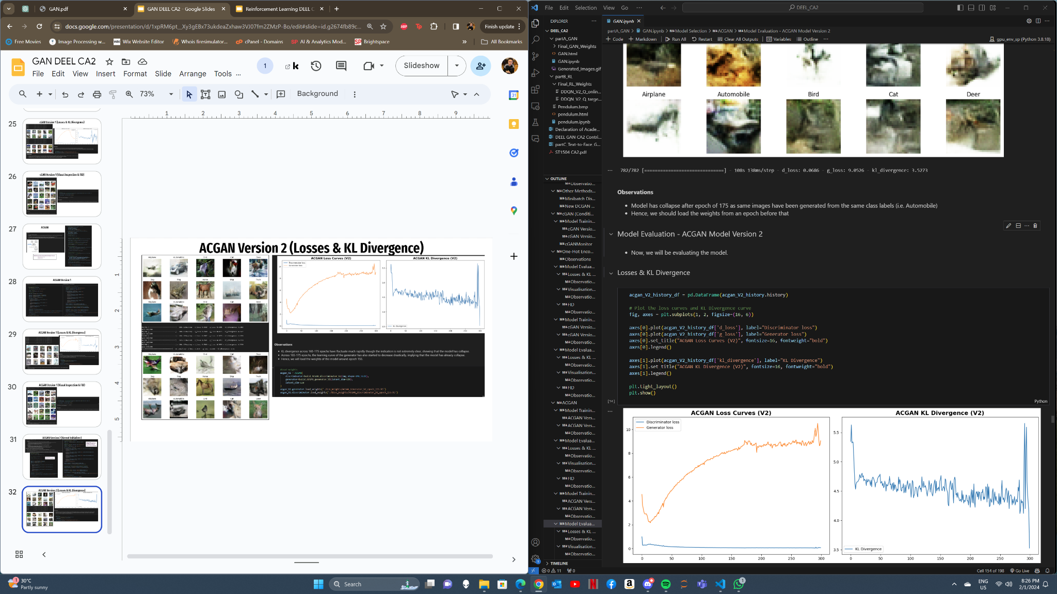
ACGAN Version 2 (Losses & KL Divergence)

Slide 33


ACGAN Version 2 (Visual Inspection & FID)

Slide 34




ACGAN Failed Attempt (Spectral Normalization)
Model Collapse as seen in repeating images in Automobile

Slide 35


Final Model (ACGAN Kernel Initializer)
NOTE: This is a gif
Images generated are much clearer as features in each class are extremely clear

Slide 36
Summary
In summary, we have noticed that the images produced by ACGAN are fairly realistic, but some of the images are quite distorted. The model was better at generating images of vehicles compared to animals. It's harder for the models to form parts of the animals as the animals come in different color, shape and sizes, making hard for the GAN model to learn the features of the images.
Some potential issues with the images:
Animals like cats and dogs are still not fully formed (i.e. Disappearing eyes, legs & ears)
Some images are distorted, full of noise
Some vehicles do not have the wheels and their bodies fully formed

